Slide 1
Australia’s Colourful Path to Tuberculosis Freedom
(Lessons learned from the successful bTB eradication programme in Australia)
Ron Glanville
Notes:
The originally advertised title of my talk today was about the lessons learned from the Australian program
But to hopefully keep it interesting, I changed it to, ‘Our colourful path to TB freedom.

Slide 2
Notes:
Before I jump into the talk, In the spirit of reconciliation I acknowledge the Traditional Custodians of country throughout Australia and their connections to land, sea and community and extend that respect to all Aboriginal and Torres Strait Islander peoples today. Specifically I’d like to acknowledge the Kalkadoon people who are the traditional custodians of the land on which the case studies I will be discussing today was conducted.

Slide 3
BTEC
Brucellosis and Tuberculosis Eradication Campaign
Notes:
Today I’ll use the word BTEC a bit. It stands for …., although I’ll just be talking about TB.

Slide 4
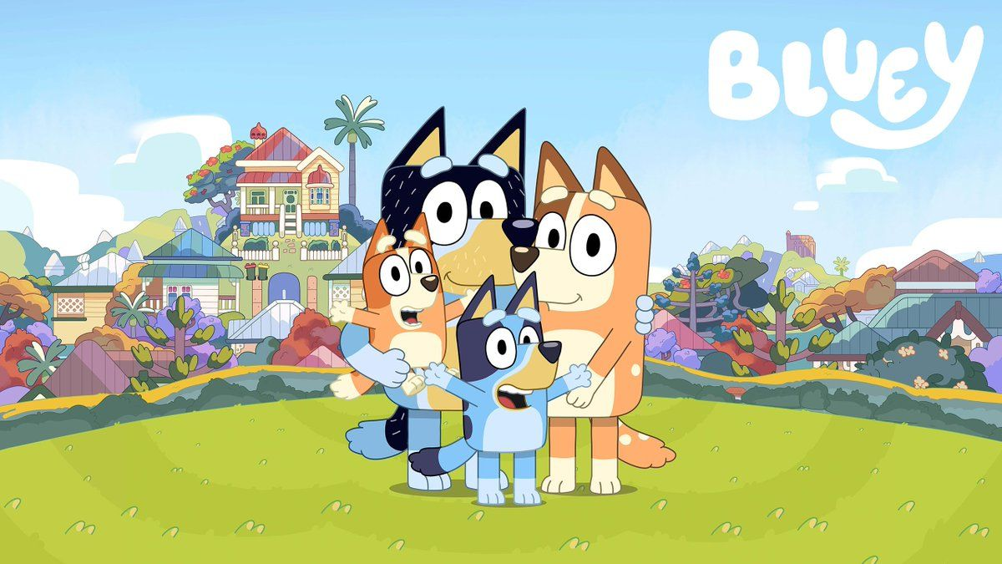
Notes:
Who has seen the kids TV program, Bluey? It’s an Australian production now shown in around 35 countries.
You may ask, what has that got to do with BTEC. If you stay awake through this talk, all will be revealed towards the end.

Slide 5
“One thing that I have learned about it - and I’ll put it in technical terms - you just don’t f@#% with TB.”
- Bob Cottam
Notes:
Apart from being a great photo, the reason I’ve used this one here is that the chap on the right is veterinary colleague, Bob Cottam who passed away in 2020.
Bob made this rather pertinent observation about tuberculosis that encapsulates much of what we learnt in Australia… and hopefully will come across in this talk.
In fact, as you will see, the Ausralian program was pretty brutal in some respects.

Slide 6
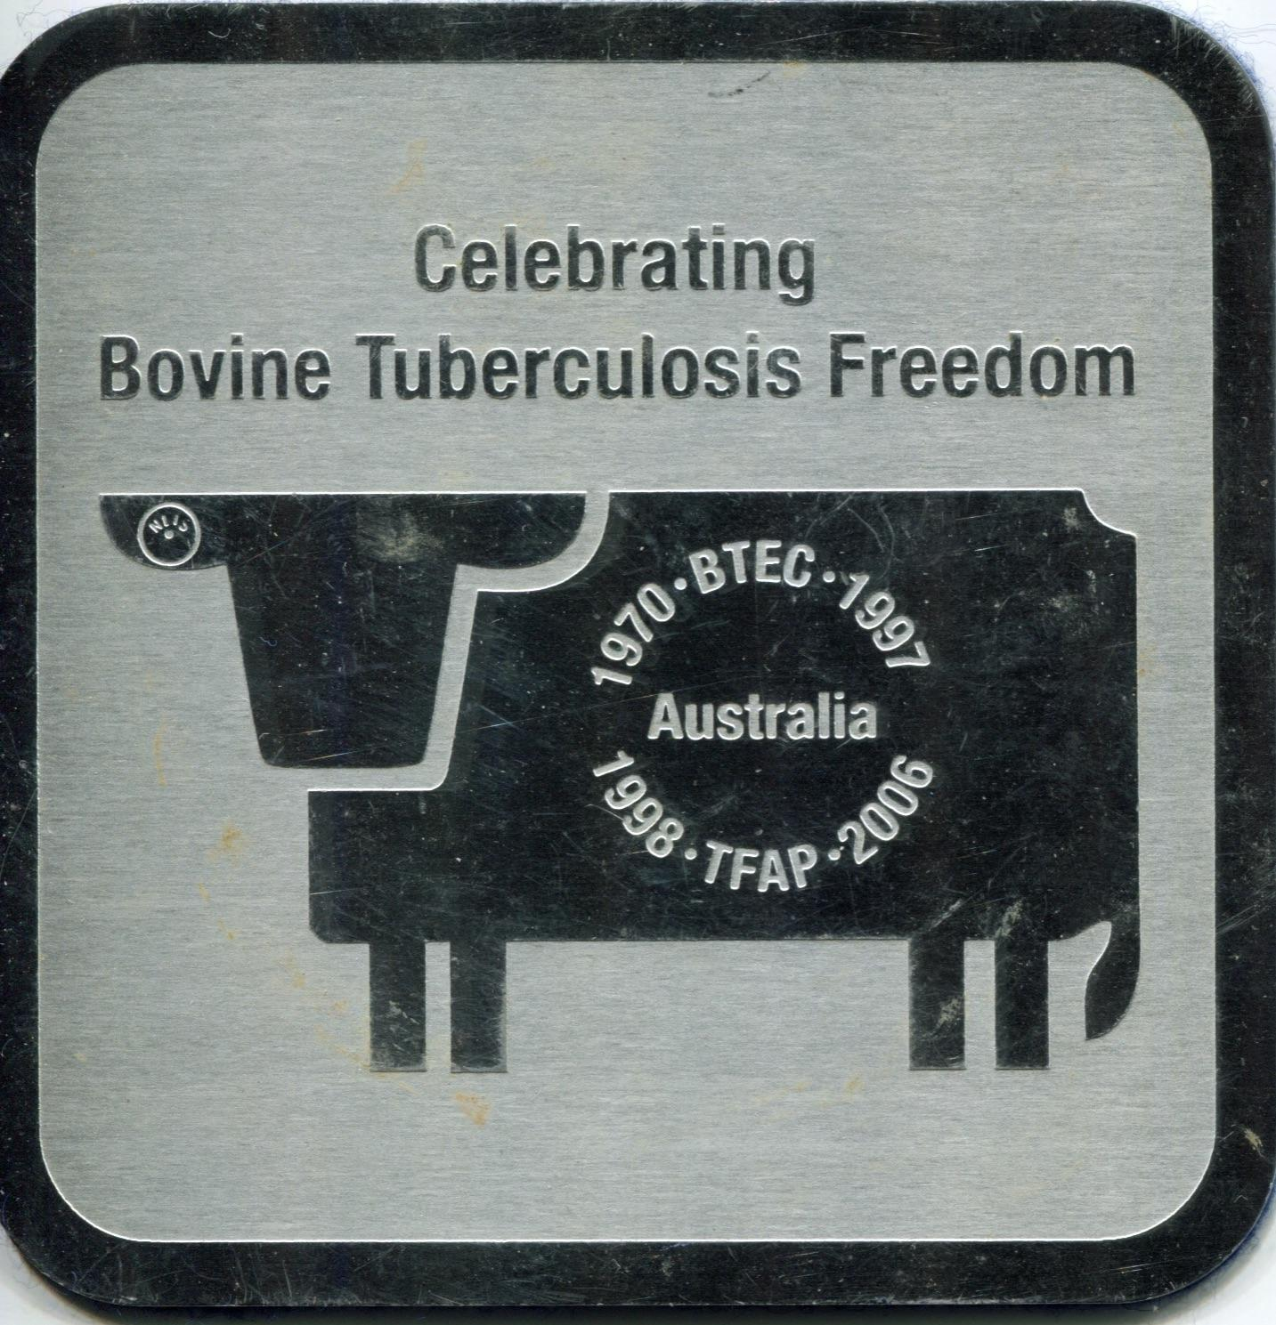
Notes:
Australia eradicated bovine tuberculosis over a 27-year period from 1970 when BTEC commenced, through to when TB freedom was declared on 31 December 1997.
Note that much had occurred in the decades previous to 1970 to reduce prevalence and largely eliminate infection from the dairy industry.
The original impetus was to ensure ongoing international market access for our beef, given that we export around ¾ of what we produce.
The key elements of this AUD$1 billion program have been well documented (in fact there’s even a book about it) and I’ll touch on some of this later. However, first I’ll attempt to add the ‘colour’ by reflecting on my personal experiences in the far north-west of Queensland during the very difficult latter phases of the program from the mid 1980s.

Slide 7
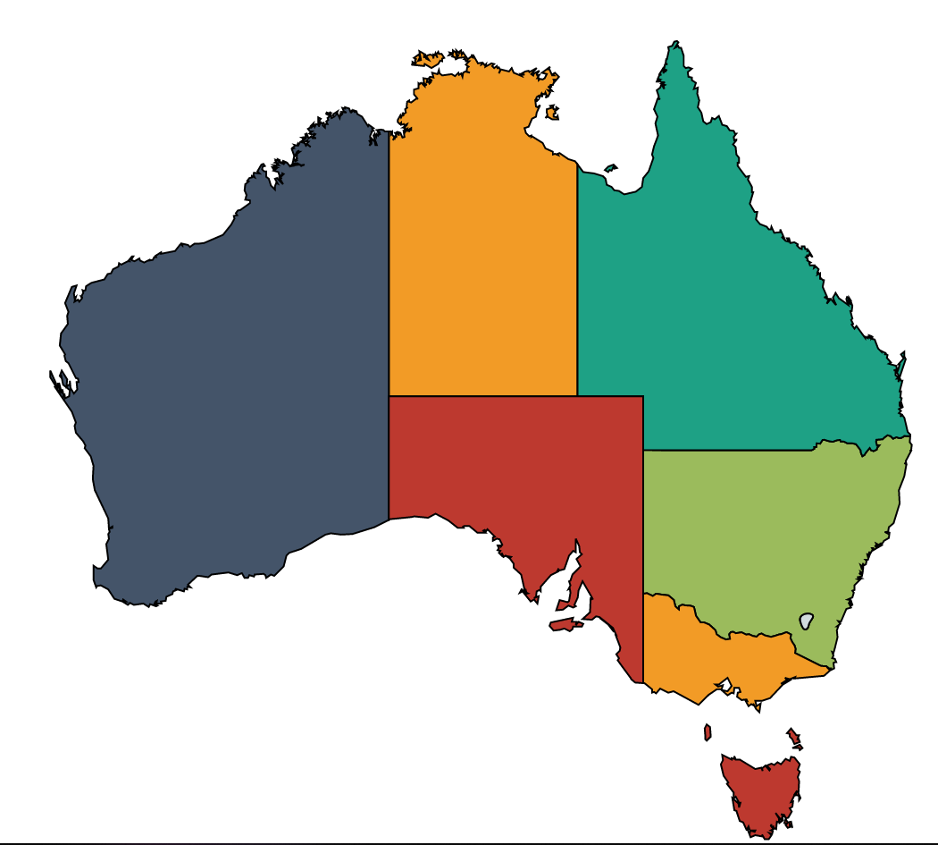
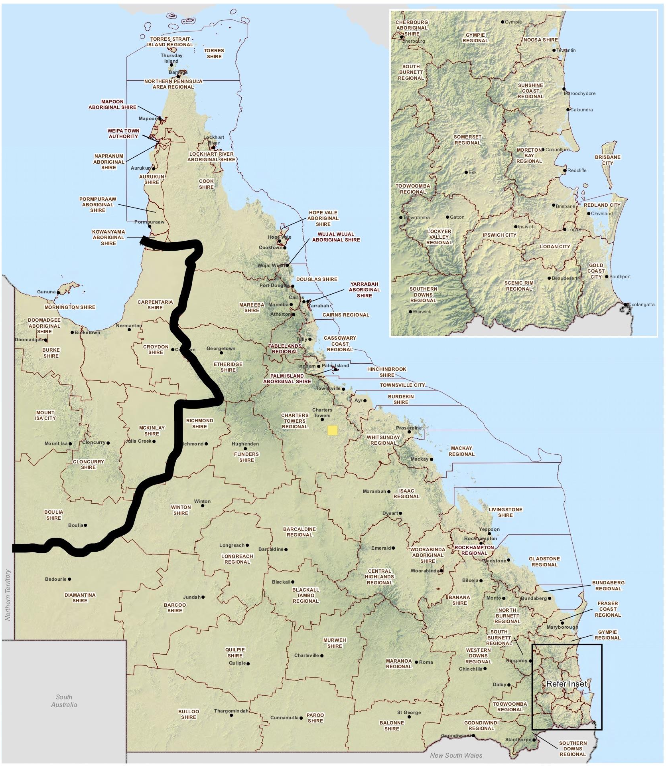
Mount Isa Veterinary Division
Notes:
In 1987 I was transferred to the Mt Isa Vet Division with the brief to finalise TB eradication in that area.

Slide 8
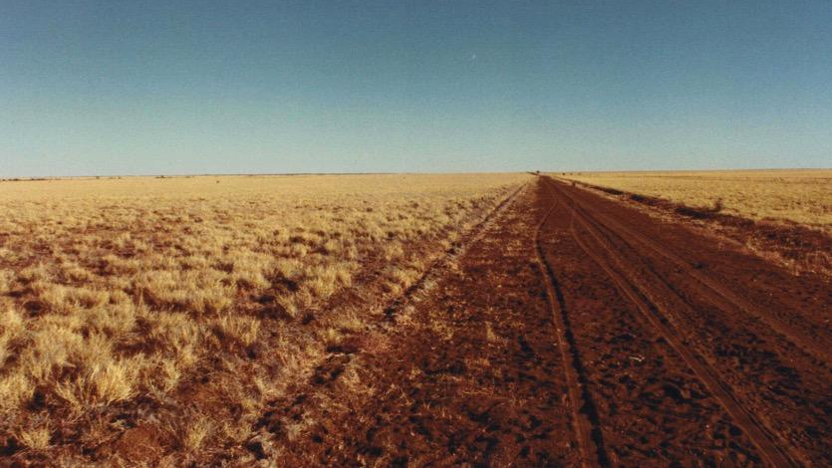
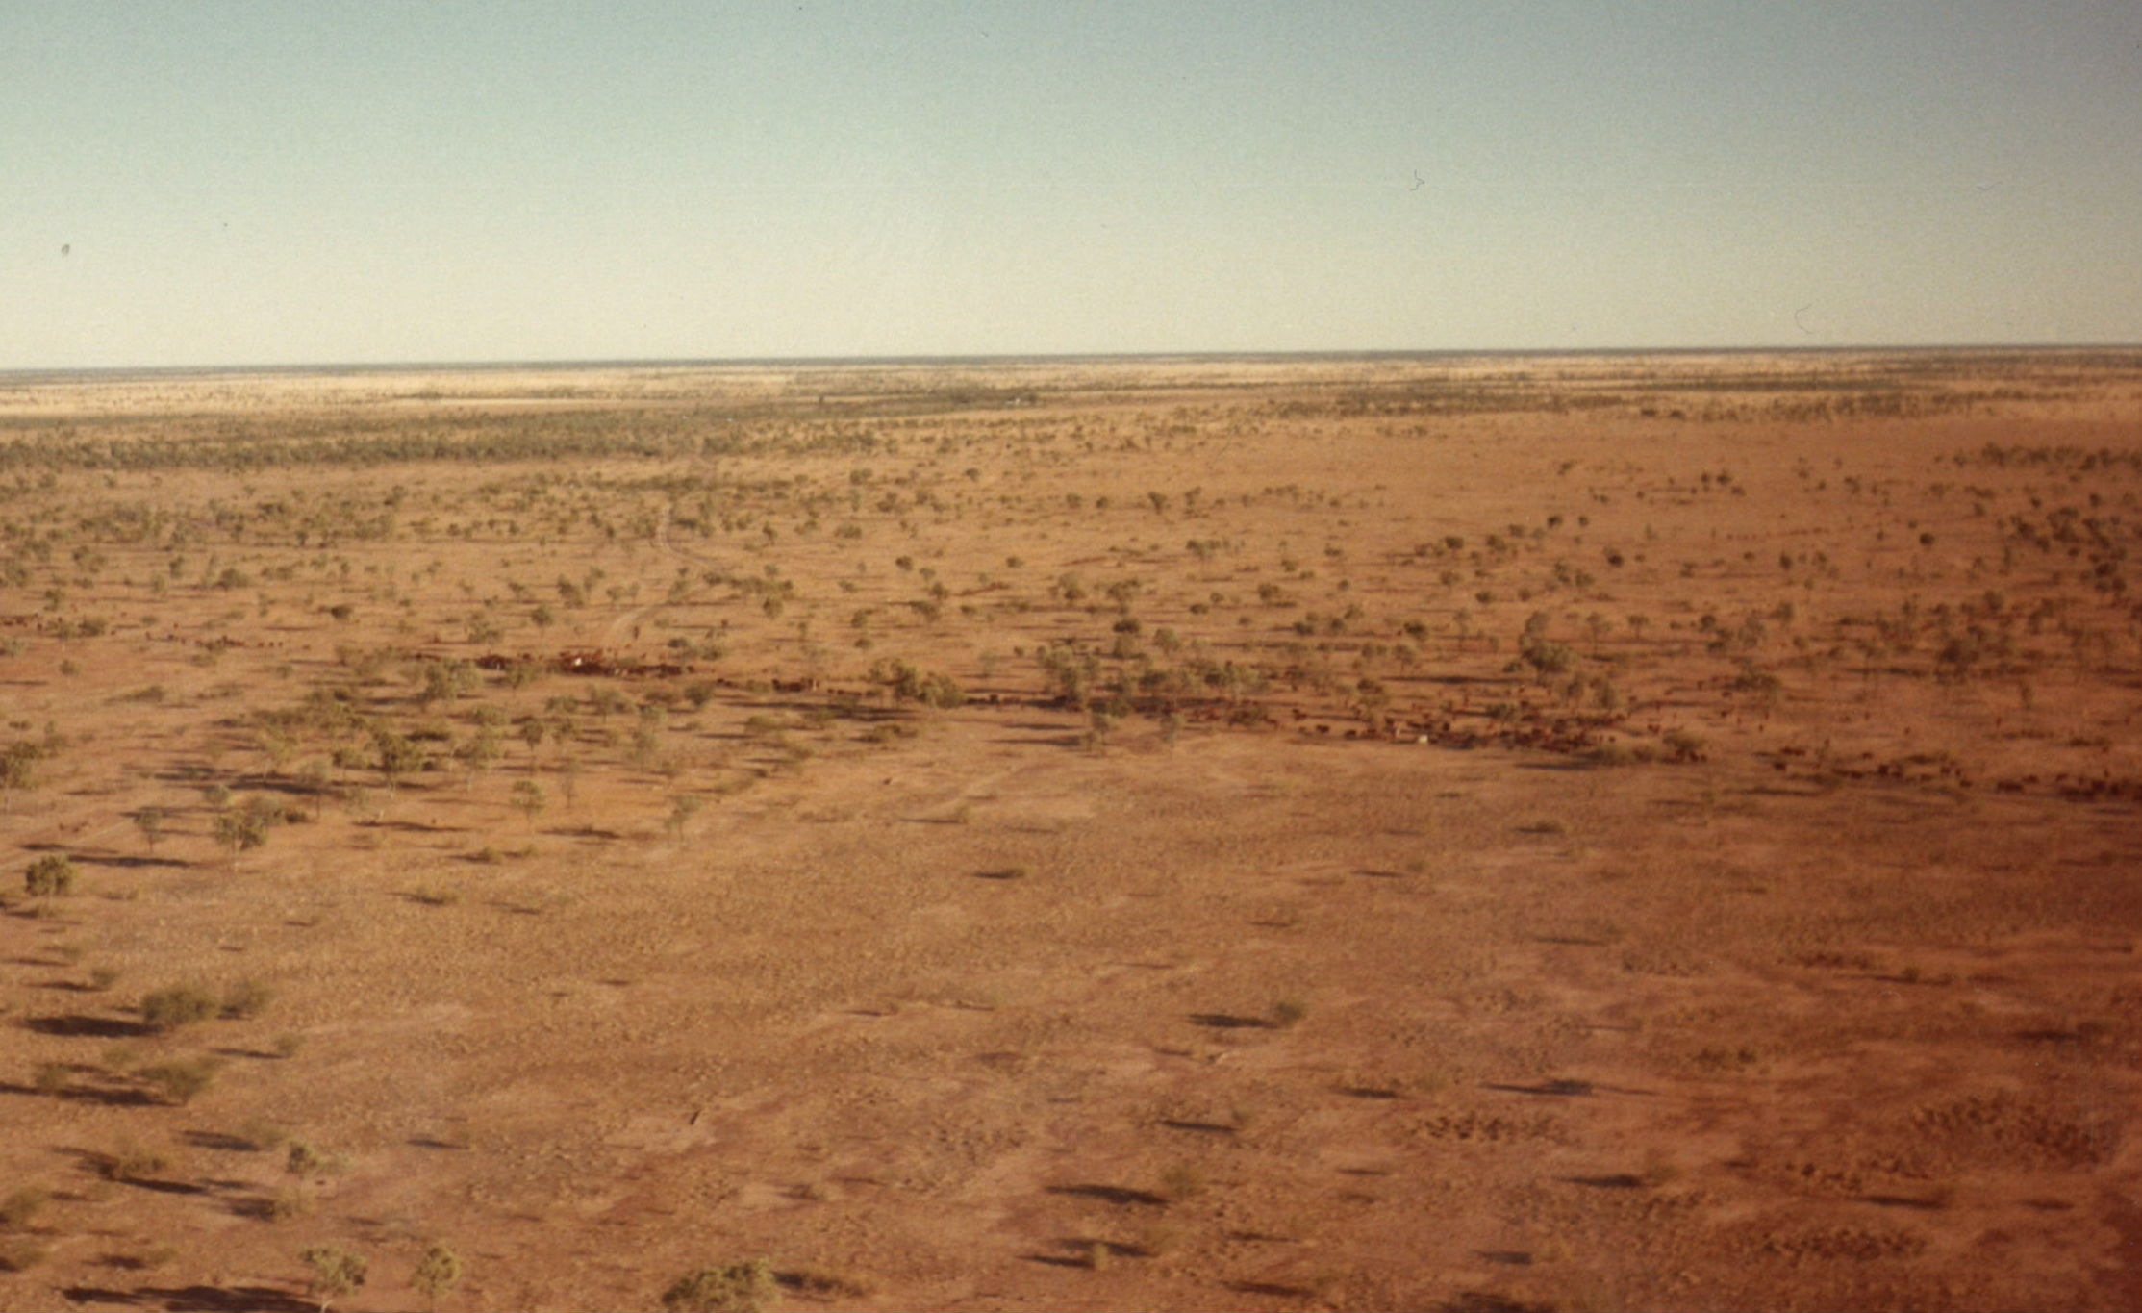
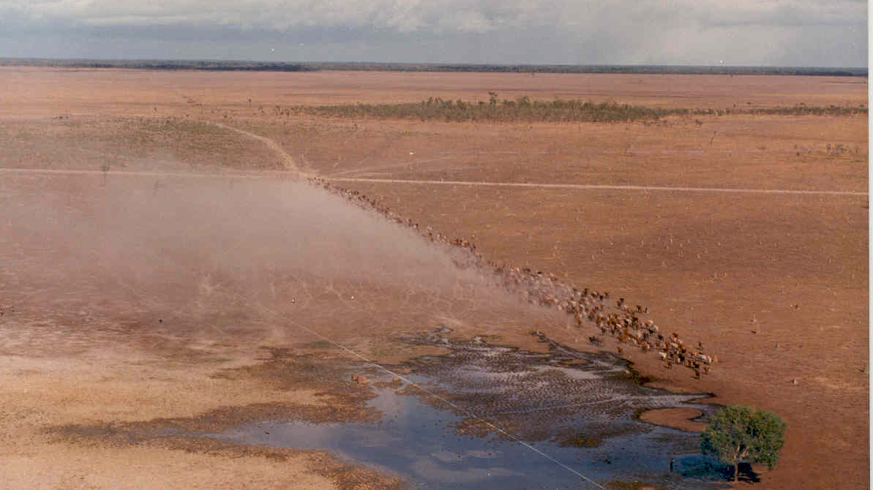
Notes:
The region is characterised by big and rugged country and large cattle stations.

Slide 9
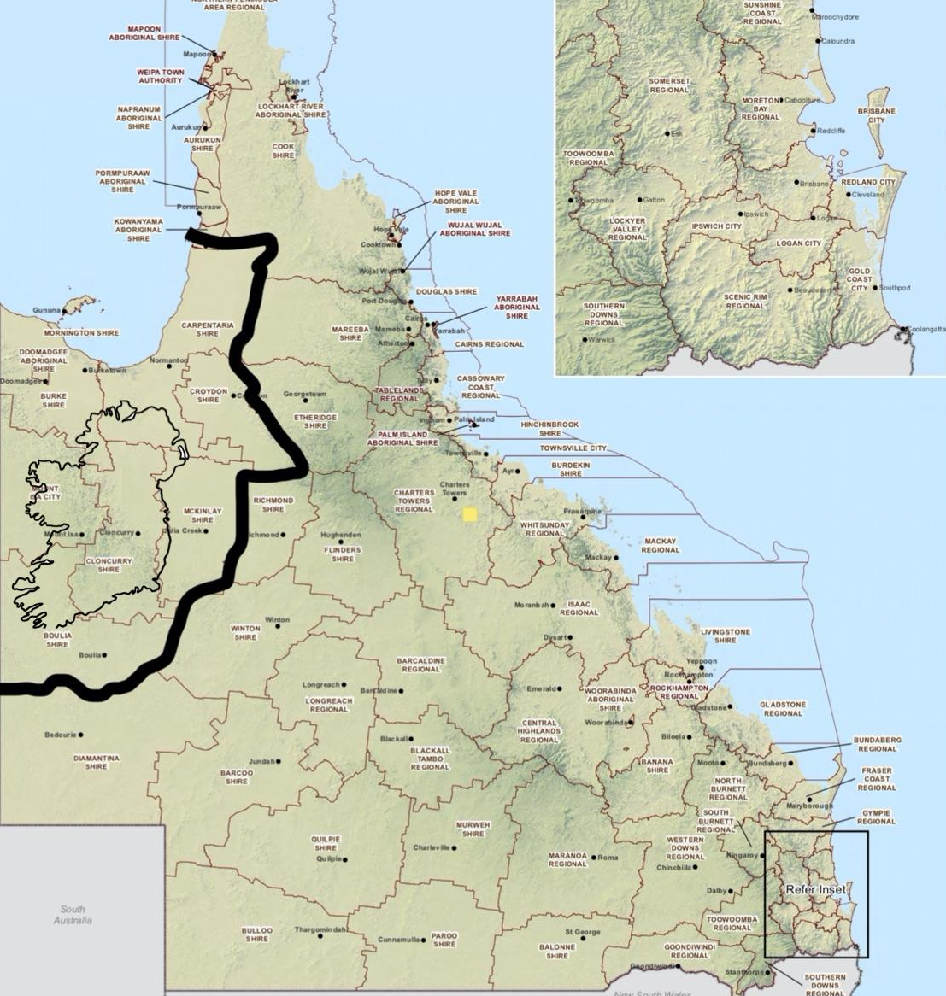
Notes:
The Division was roughly twice the size of Ireland,

Slide 10
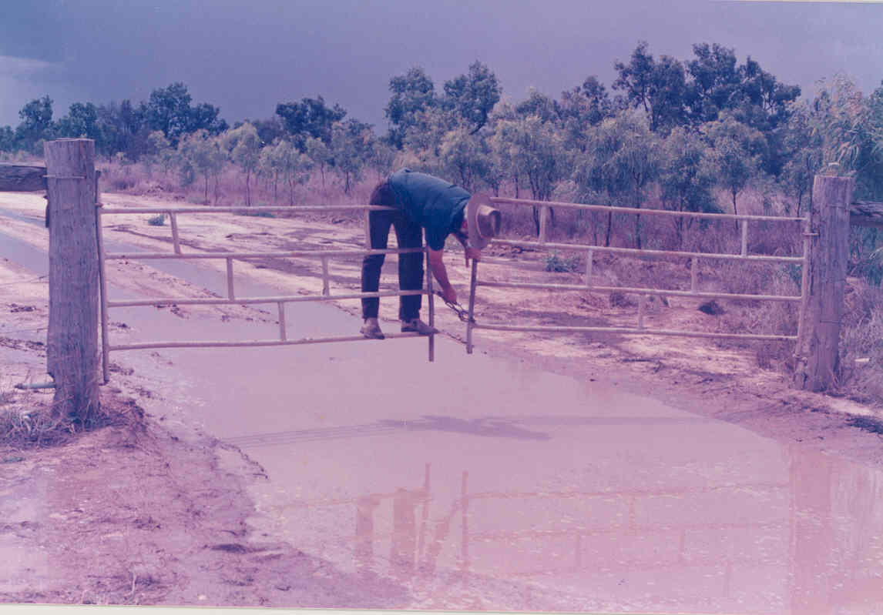
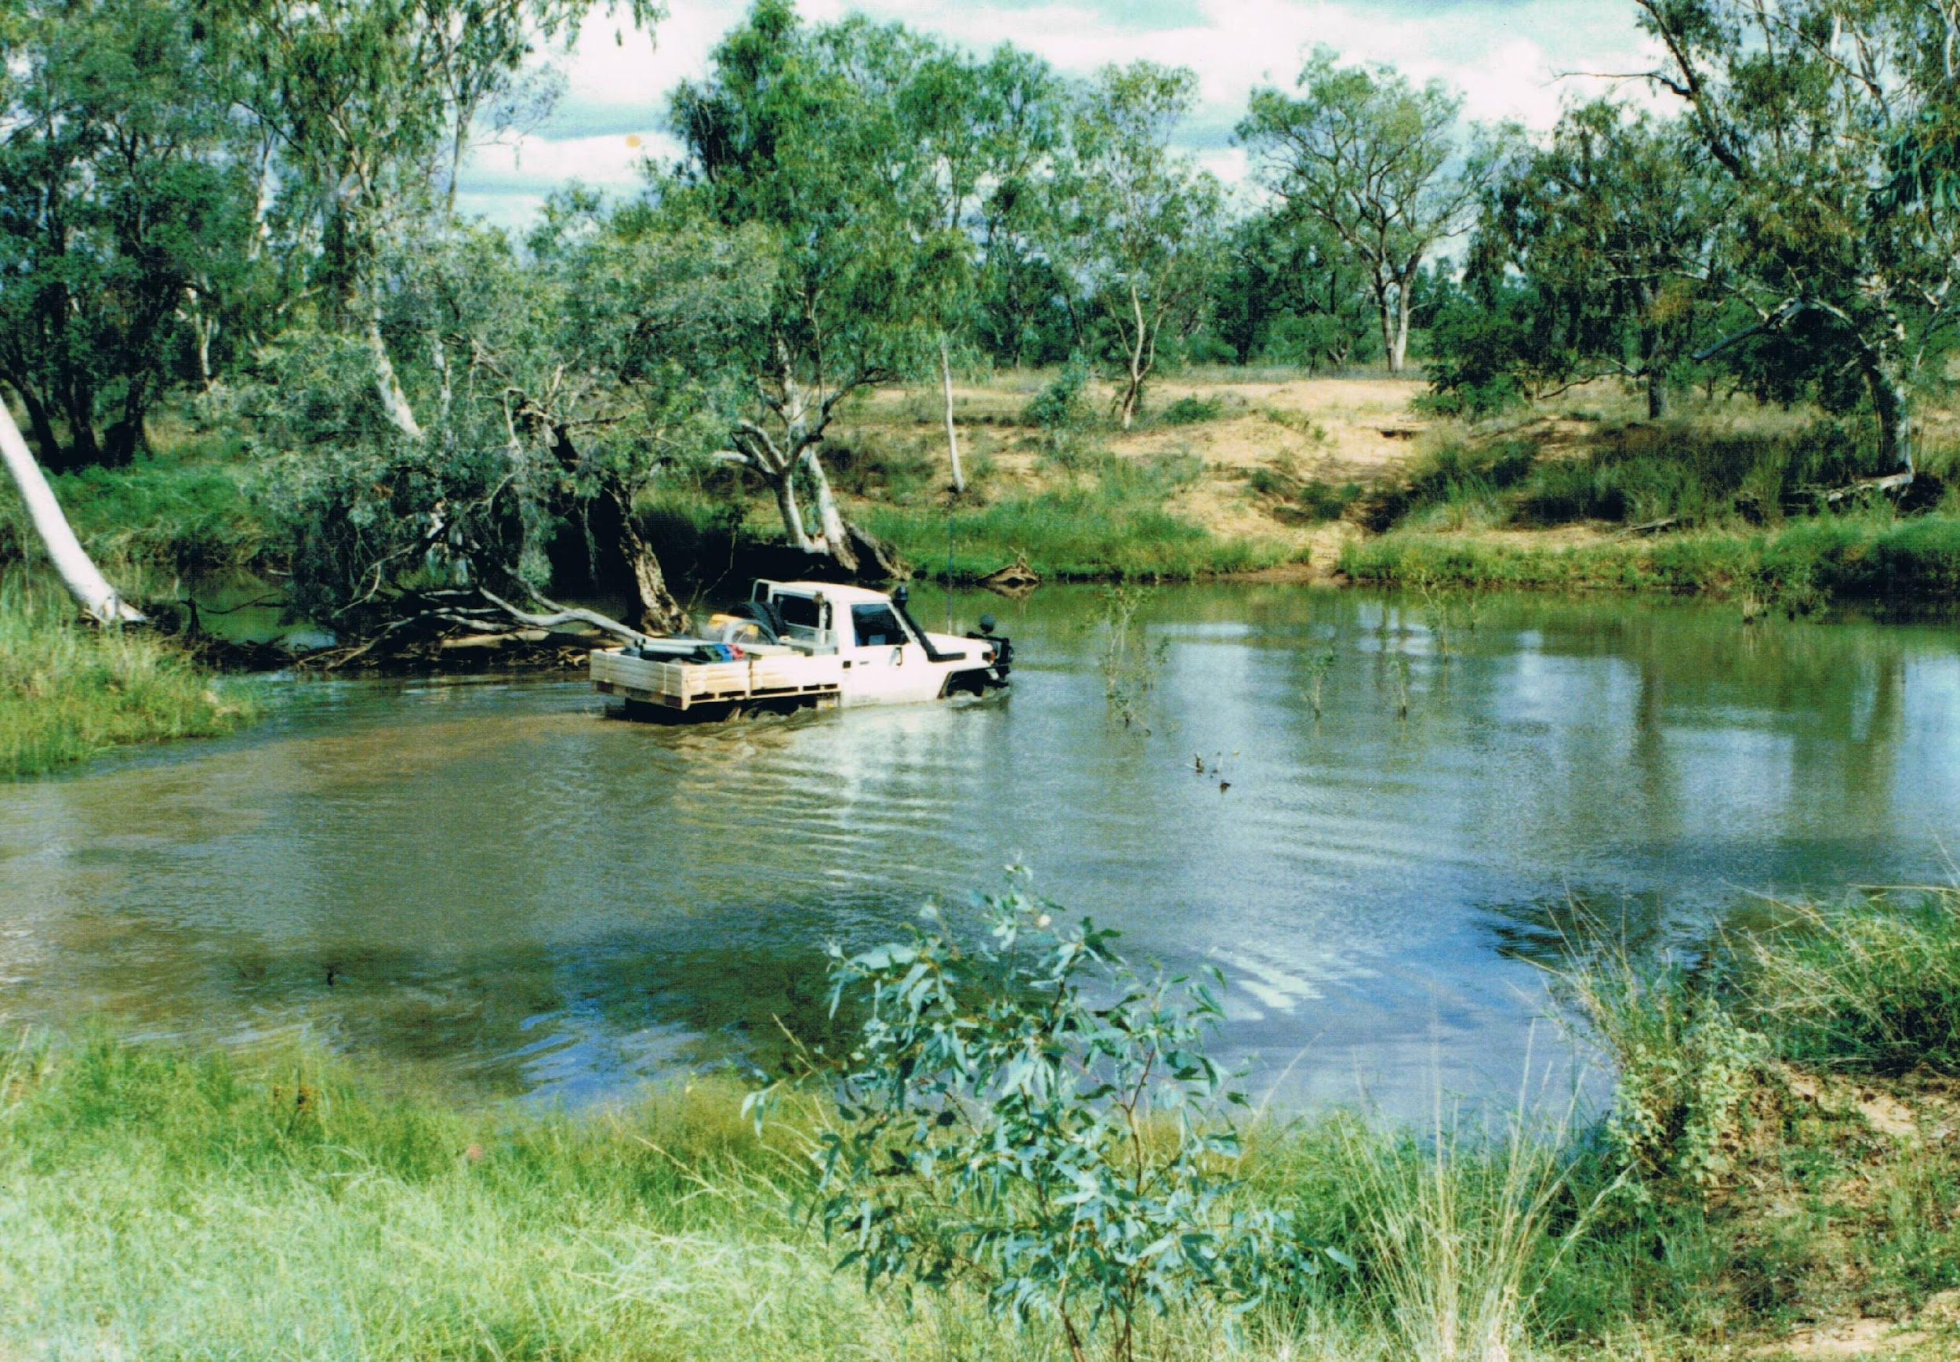
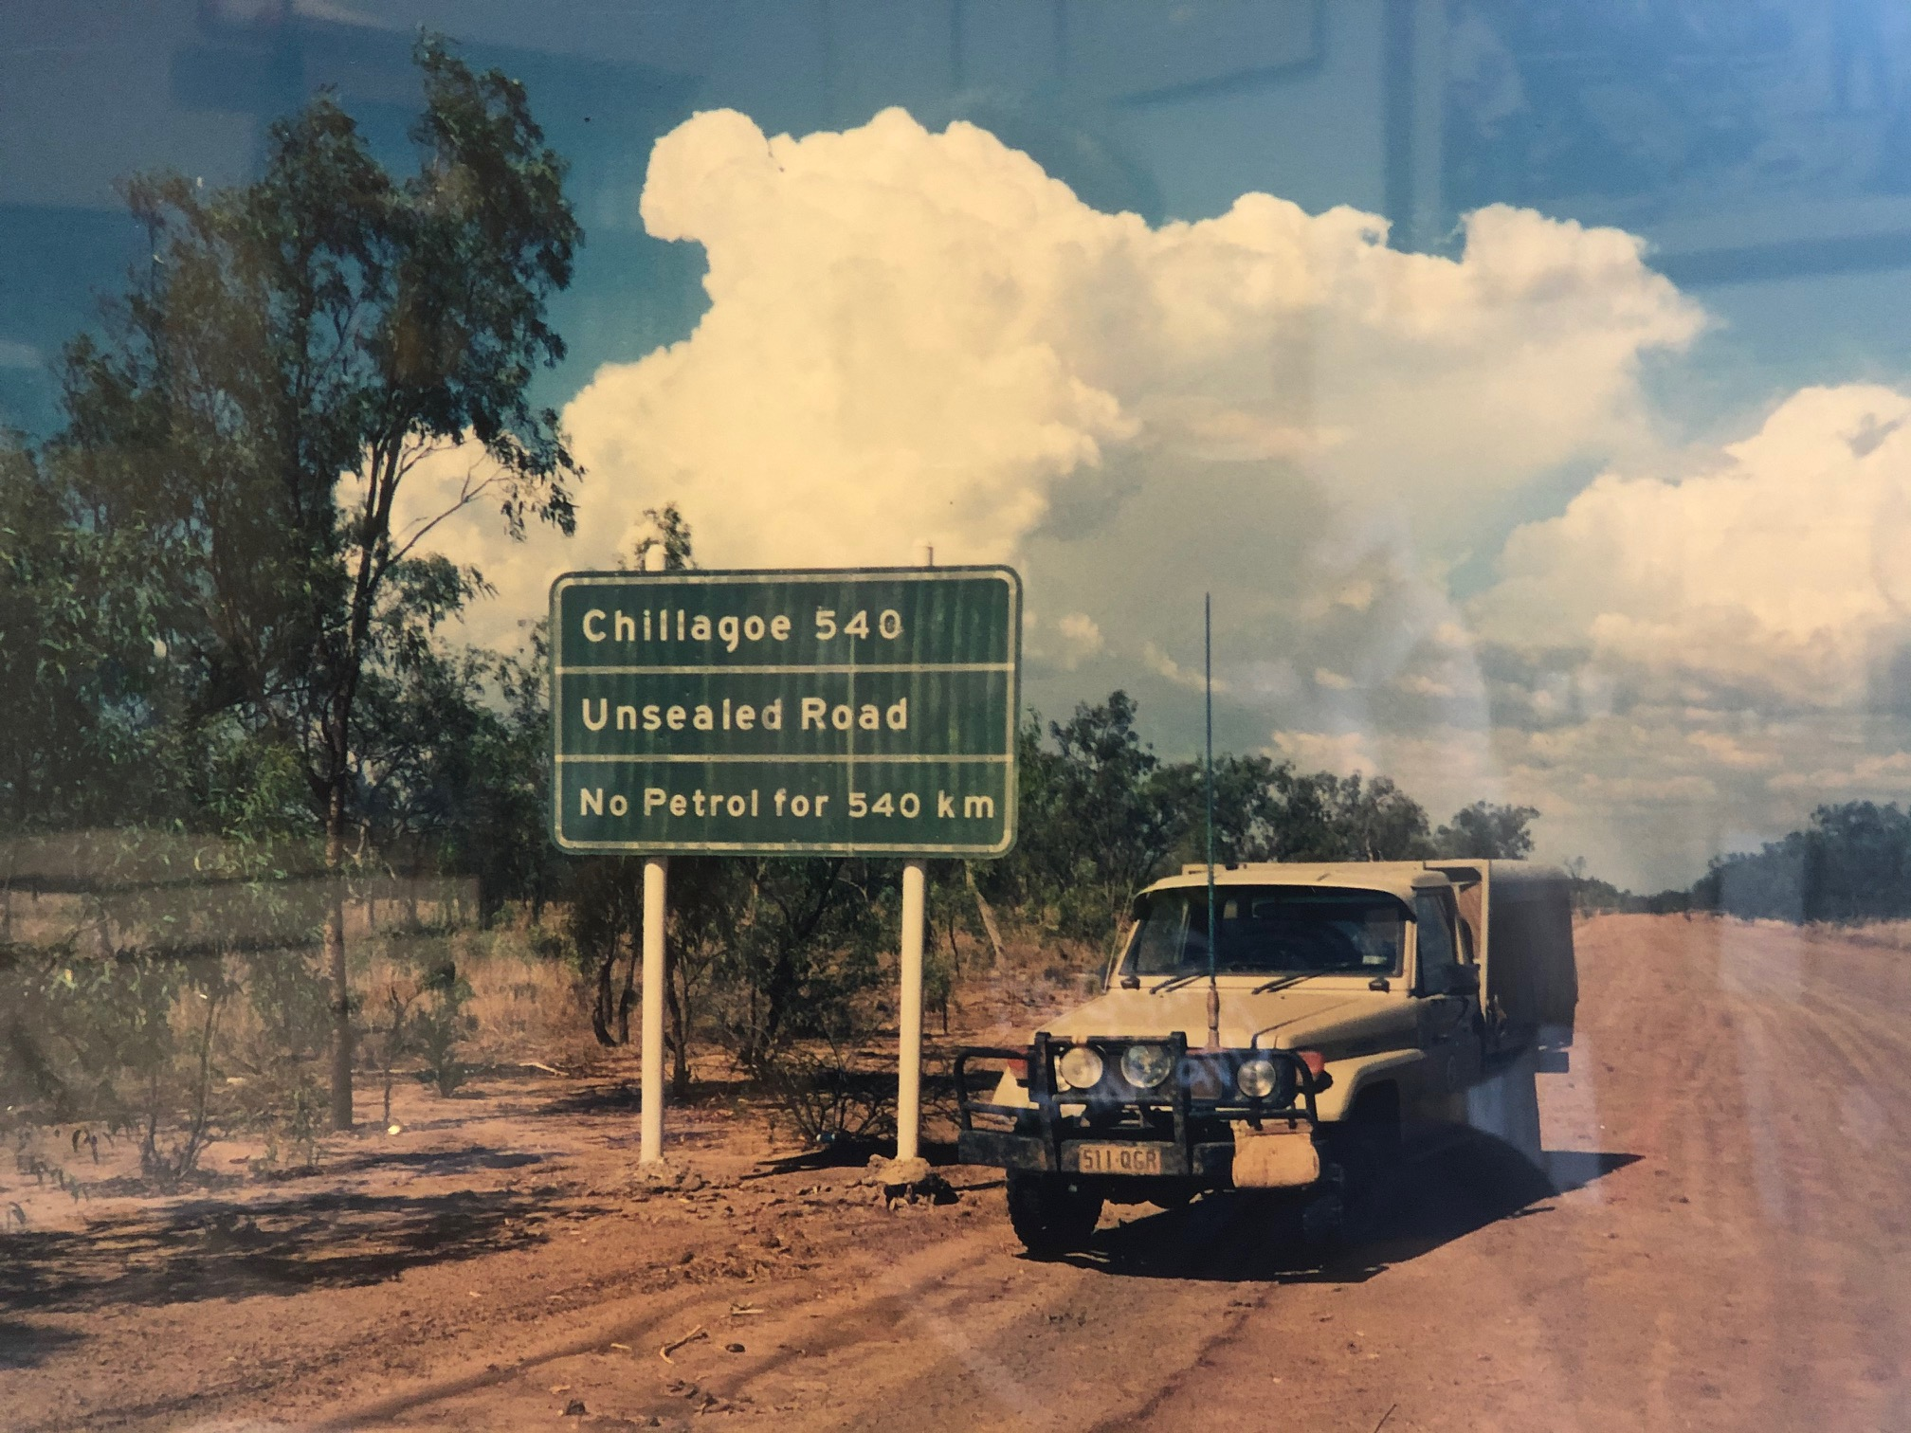
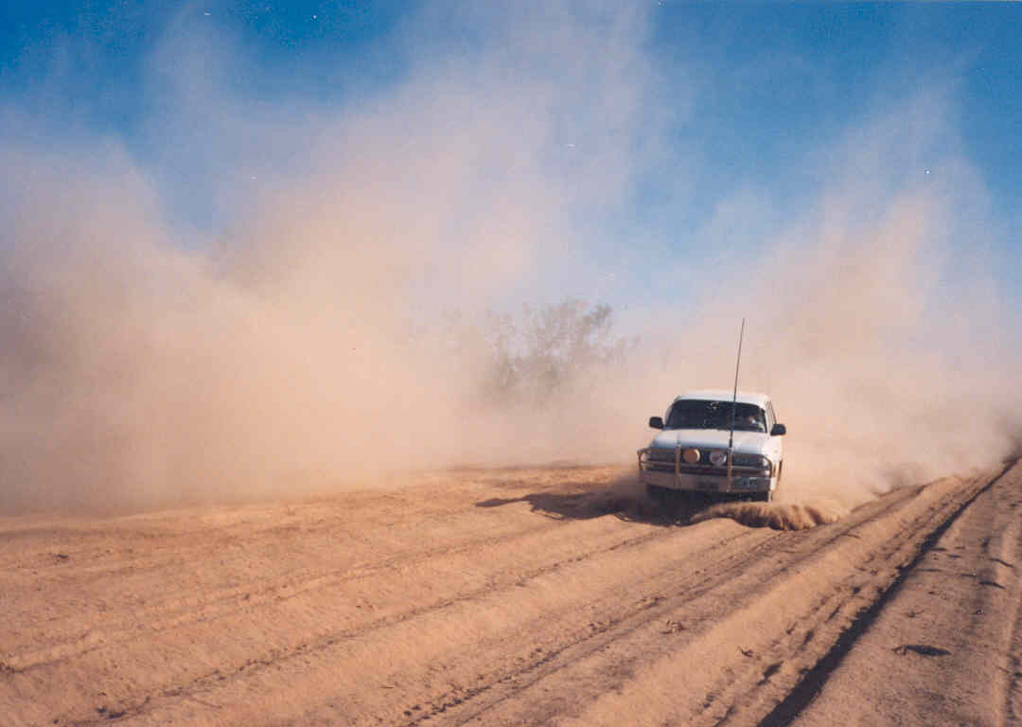
Notes:
At times it was pretty difficult to get around.

Slide 11
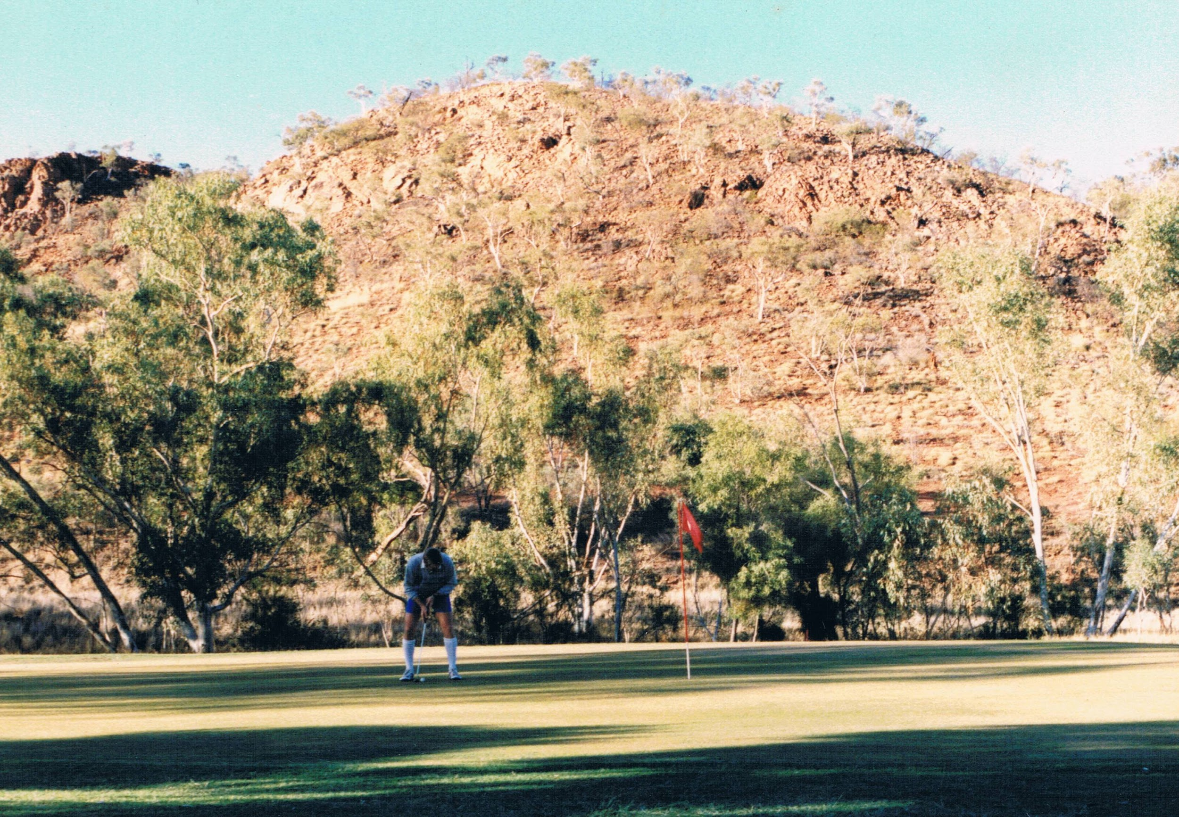
Notes:
..and even the golf courses were pretty rough.

Slide 12
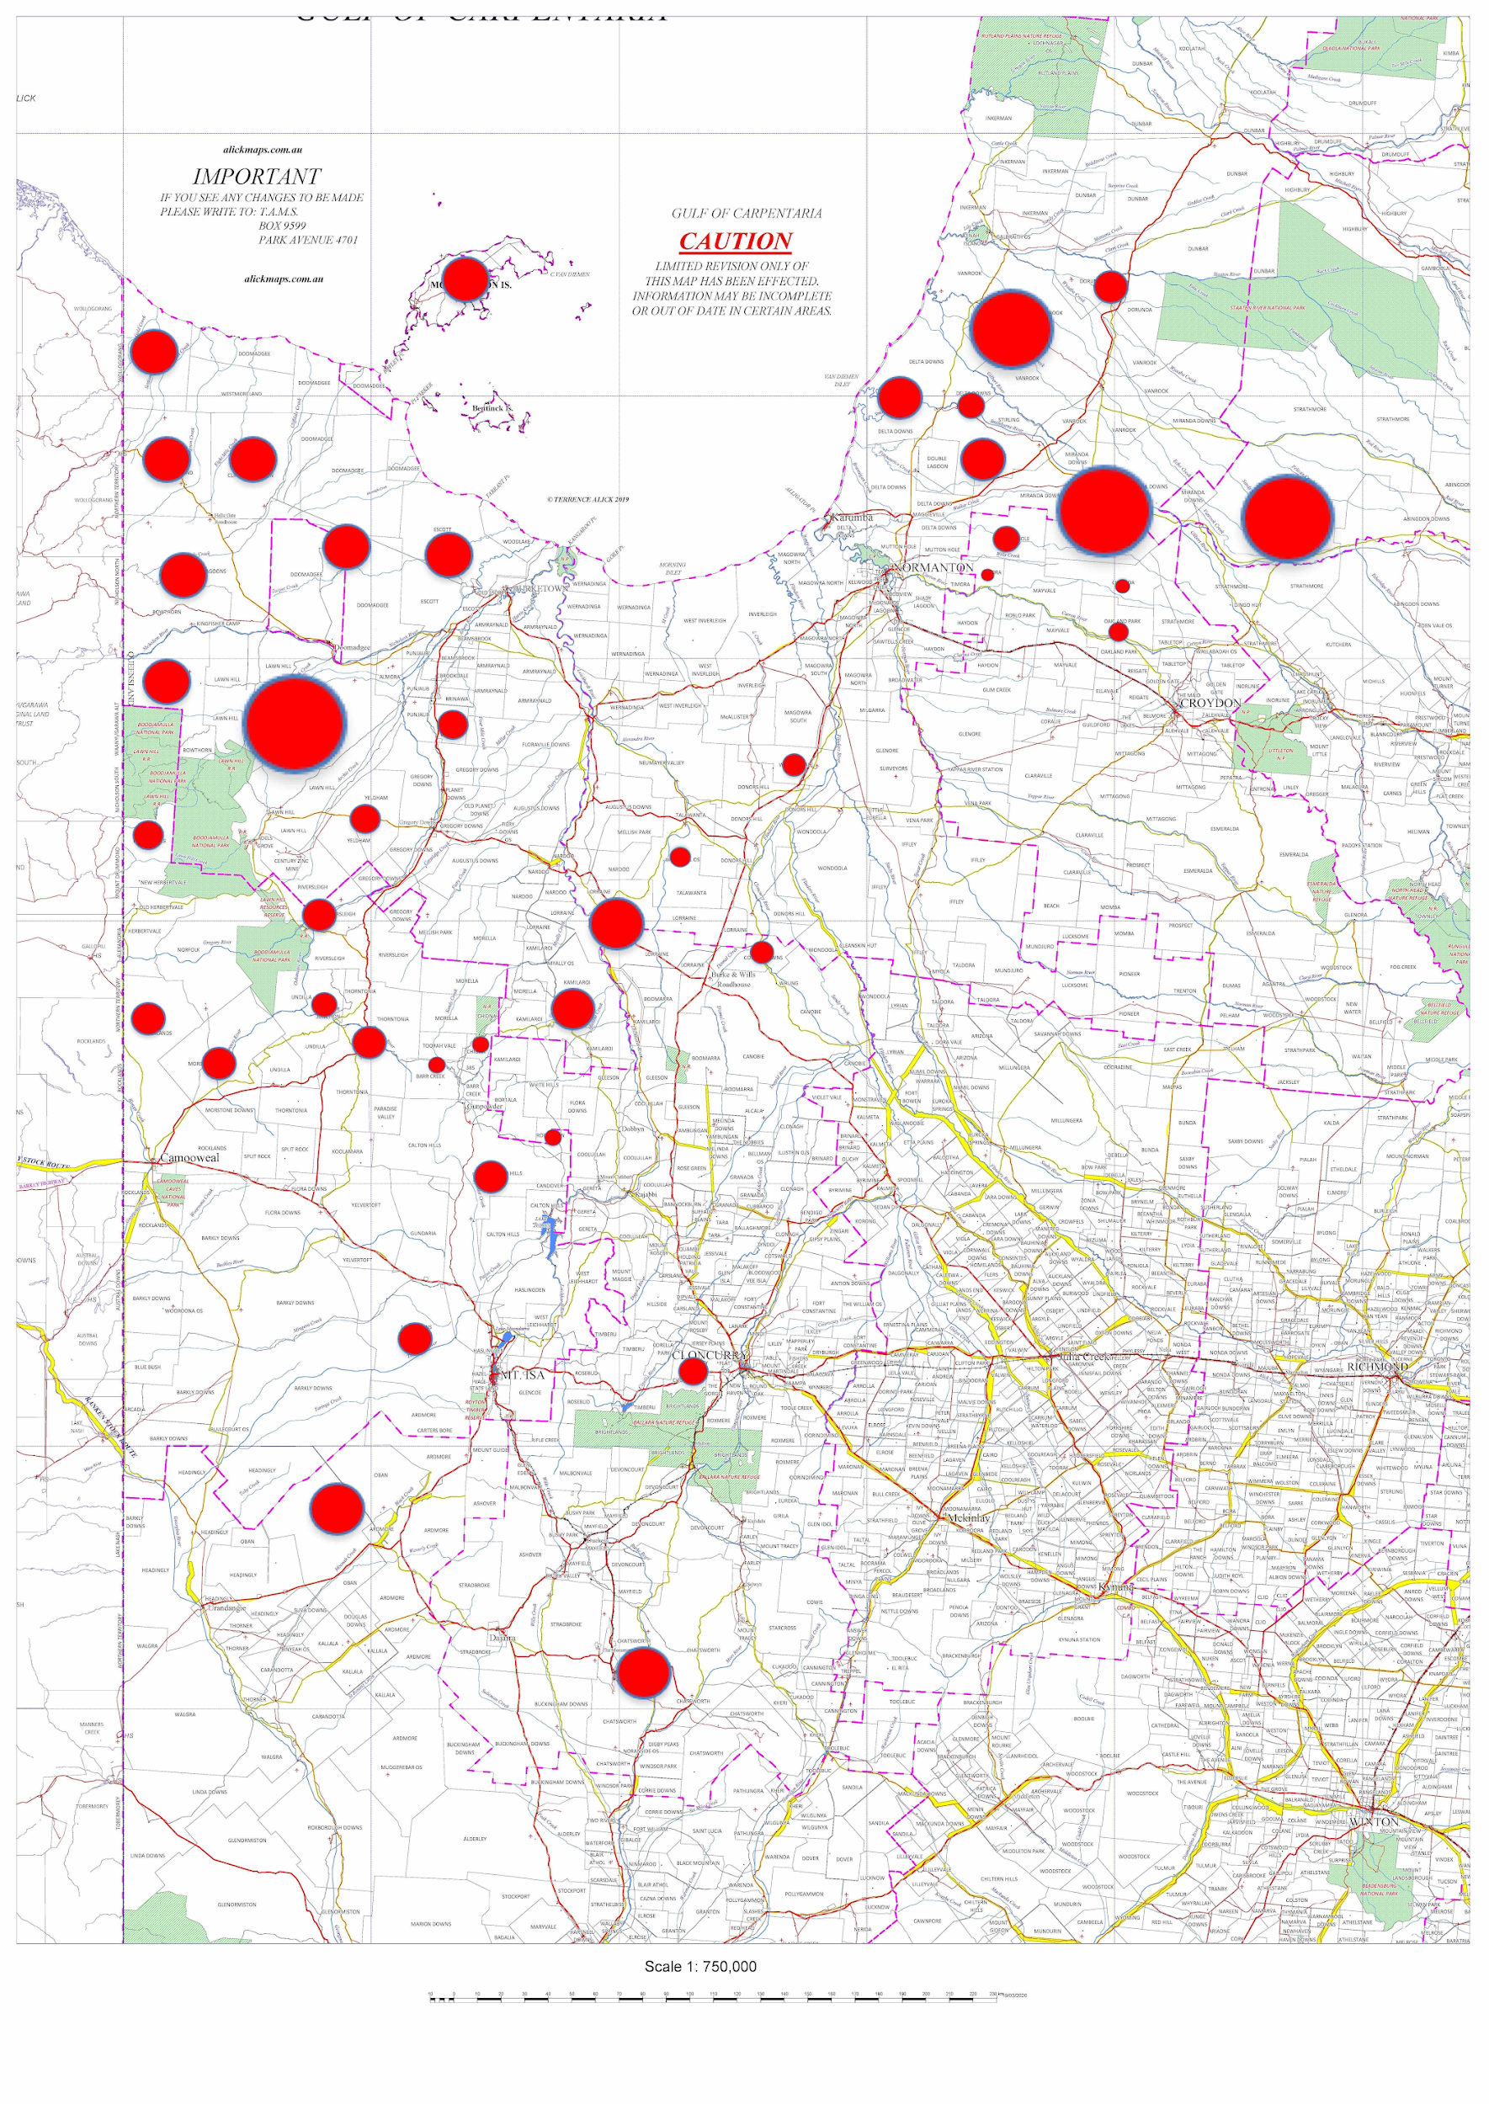
1987 > 50 Infected premises out of:
400 total cattle stations
Cattle population of 1 million head
Aim:
Impending Freedom by 1 January 1990.
Criteria:
Previously a Provisionally Free area
No known Infected or Restricted herds at the time of declaration
Capacity to eradicate any breakdown within 24 months of detection
Notes:
In 1987 there was still a large proportion of infected premises. Note that a lot of work had occurred in the preceding years to significantly reduce prevalence.
The aim was to reach Impending freedom by 1990…, which means.

Slide 13
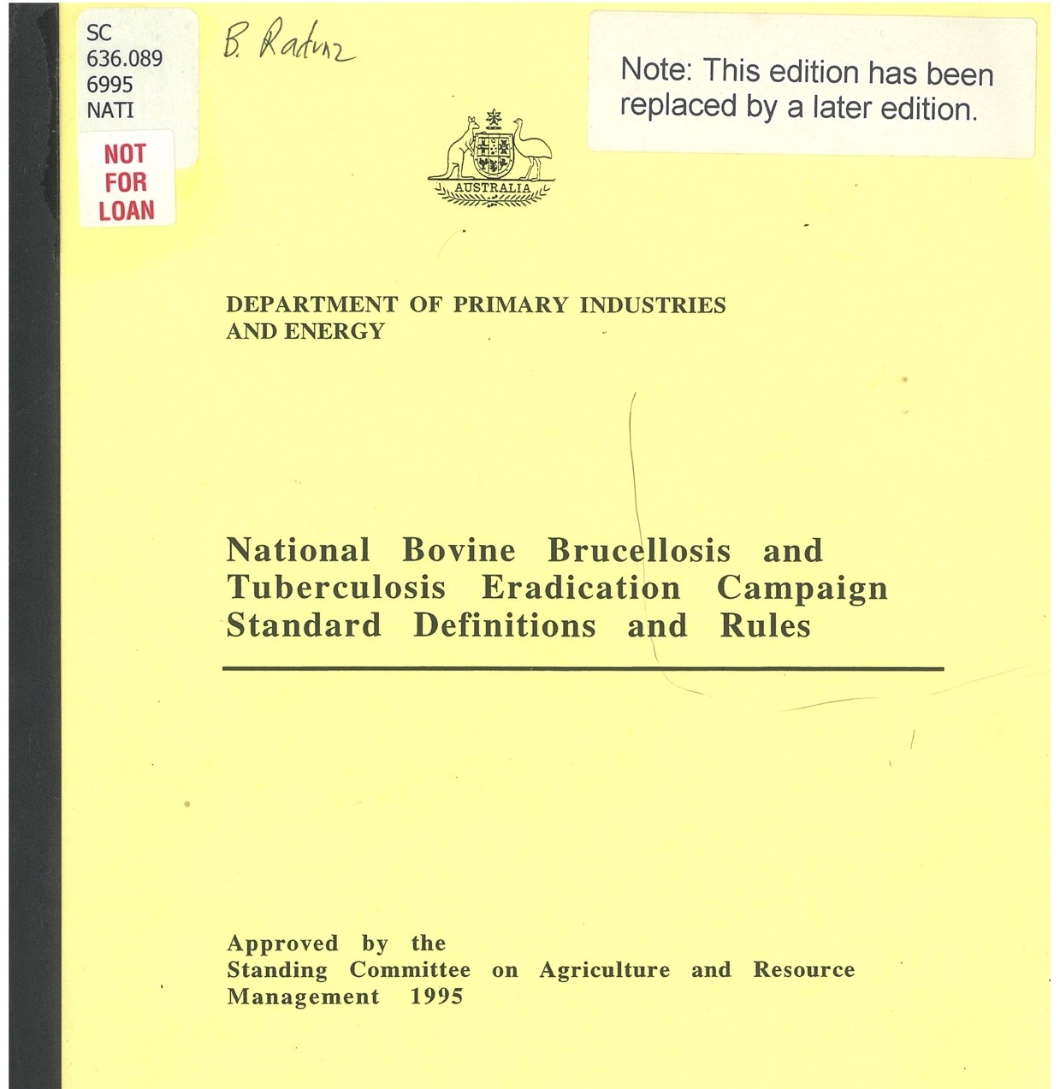
Notes:
In the previous slide I introduced some new terms such as Impending Freedom, ‘Infected Herd’, ‘Restricted Herd’.
These and many others were defined in our Bible, the ‘Standard Definitions and Rules’.

Slide 14
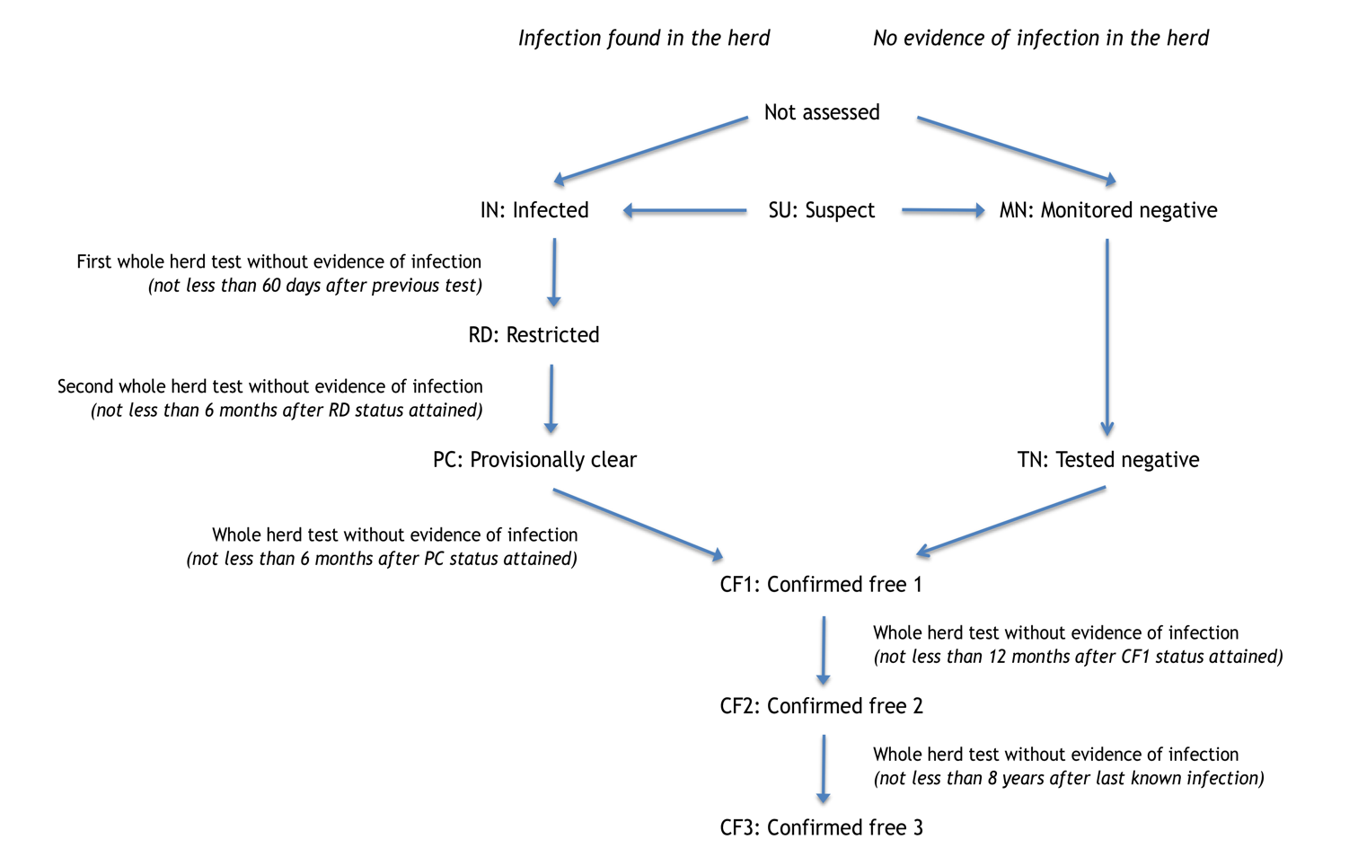
TB Herd Status Progression
Notes:
For example, this diagram explains the standard progression of herd statuses from Infected, to Restricted, to Provisionally Clear to Confirmed Free etc.
I won’t go into the detail of this here, but see me afterwards if you are interested.

Slide 15
CHALLENGES
Notes:
In this region, and many other parts of the North we faced a number of significant challenges….

Slide 16
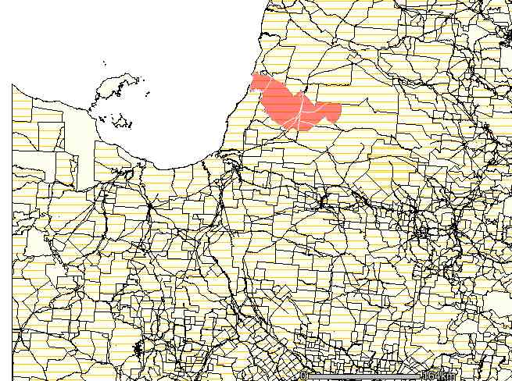
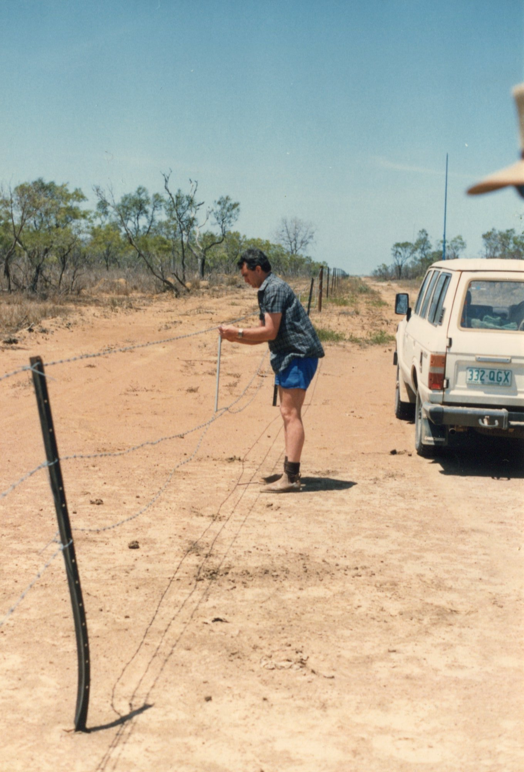
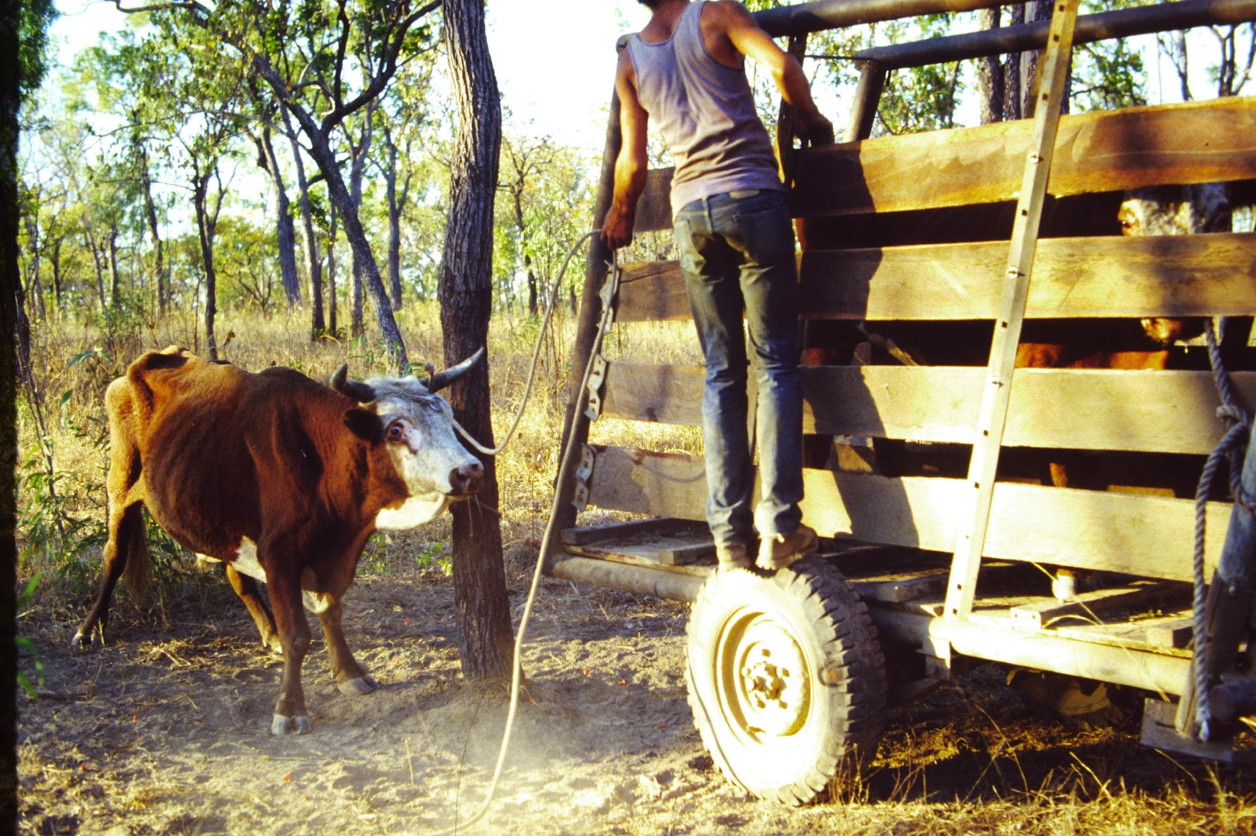
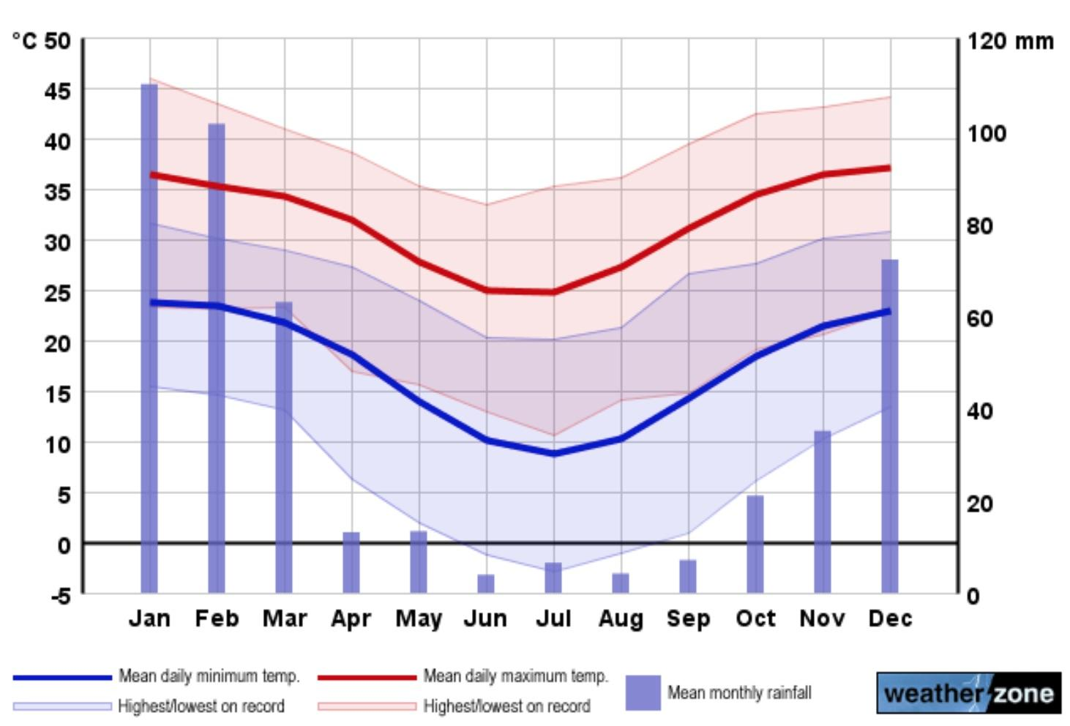
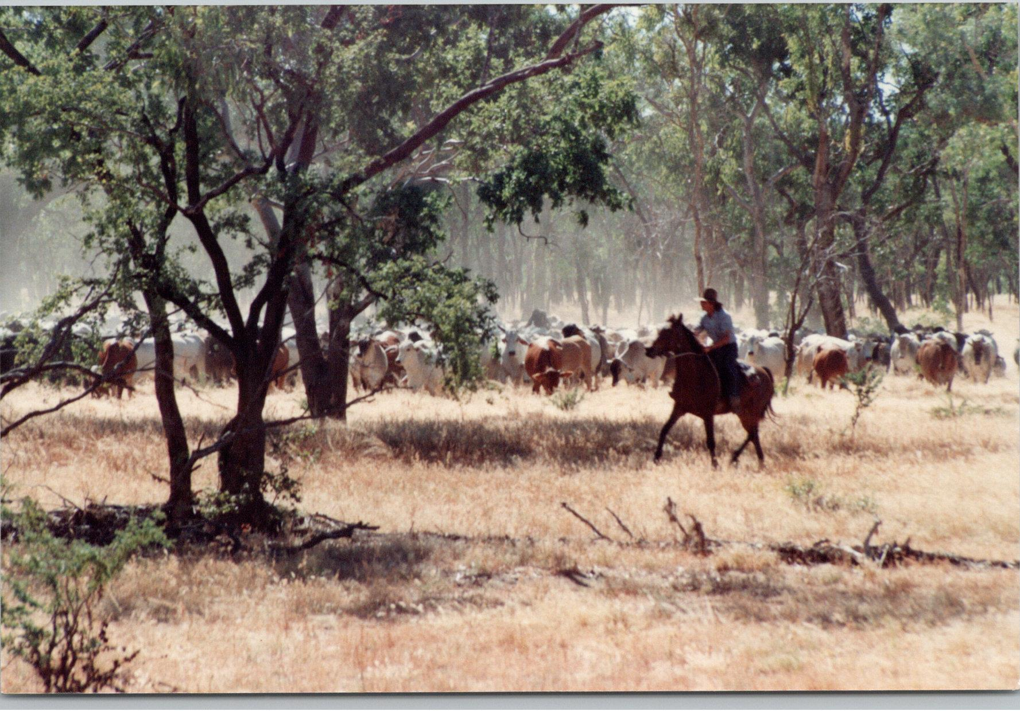
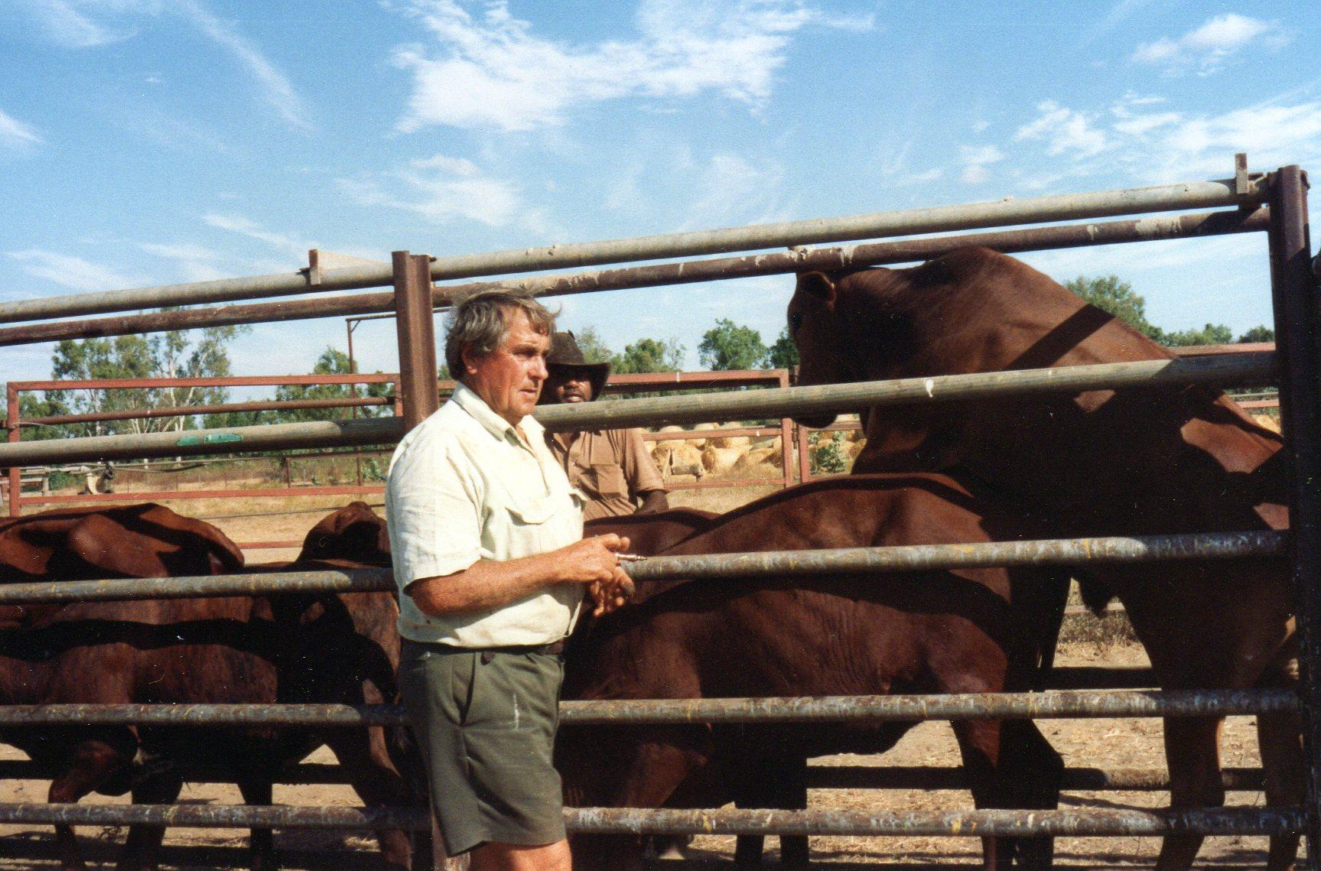
Infected Properties
Significant number of infected properties
Limited management season
Weather related
Big country
Farms = properties = stations
Wild cattle
Feral in many areas.
Lack of infrastructure
(Fences)
<100% Musters
(rounding up cattle)
Limited TB test efficacy
Notes:
Communications also not great – many stations had no telephone – just radio.
To manage all of this I had a government team of two other vets, 17 stock inspectors and a number of private vets contracted to perform TB testing.
Contracted helicopter pilots were also a key resource, as well as support elsewhere from the State policy team, laboratories etc.

Slide 17
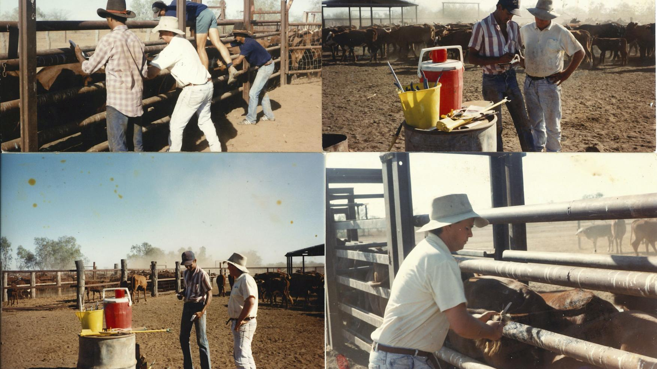
Approved Property Program
Property Details & TB History
Program Summary & Problems Anticipated
Program Details By Group, including:
Identification
Testing
Internal movements
Depopulation
Paddock / area inspections
Status progression
Assistance measures
General program conditions - clean musters, notifications, facilities etc.
Notes:
A key mechanism for achieving eradication on each individual property was the Approved Property Program, which outlined what was going to be achieved over the coming year.
These were a legal document under our legislation.
Mention each item, but emphasise the importance of clean musters and paddock inspections.

Slide 18
Case Study 1.
90km x 110 km Capacity 30,000 head
Previously infected. Reached CF1 status through testing in 1986
Complex management operation.
Notes:
To give you an idea how this all worked in practice, I’ll present a few case studies.
This first one was a very large property towards the south of the region. It had been infected but had progressed along the path to freedom by 1986.

Slide 19
Case Study 1.
TB detected again 1987.
17 TB infected animals detected 1987 – 89.
All infected mobs depopulated
Regained CF1 status 1989. (20,000 head) Mob integrity critical.
Notes:
However, infection was detected again in 1987 and we found a total of 17 infected animals over the next three years.
This was a major setback for the owners and essentially what we did was depopulate all infected groups and put all others through the testing pathway, which relied on confirming mob integrity through animal identification and paddock inspections. As you can imagine, on such a large property, this was a very complex operation.
At the end, the property was 10,000 head below carrying capacity but the remaining cattle progressed to free status without incident.

Slide 20
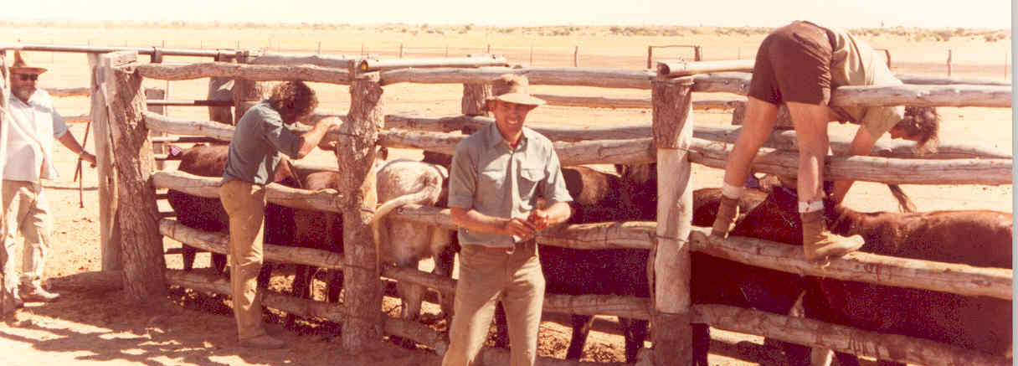
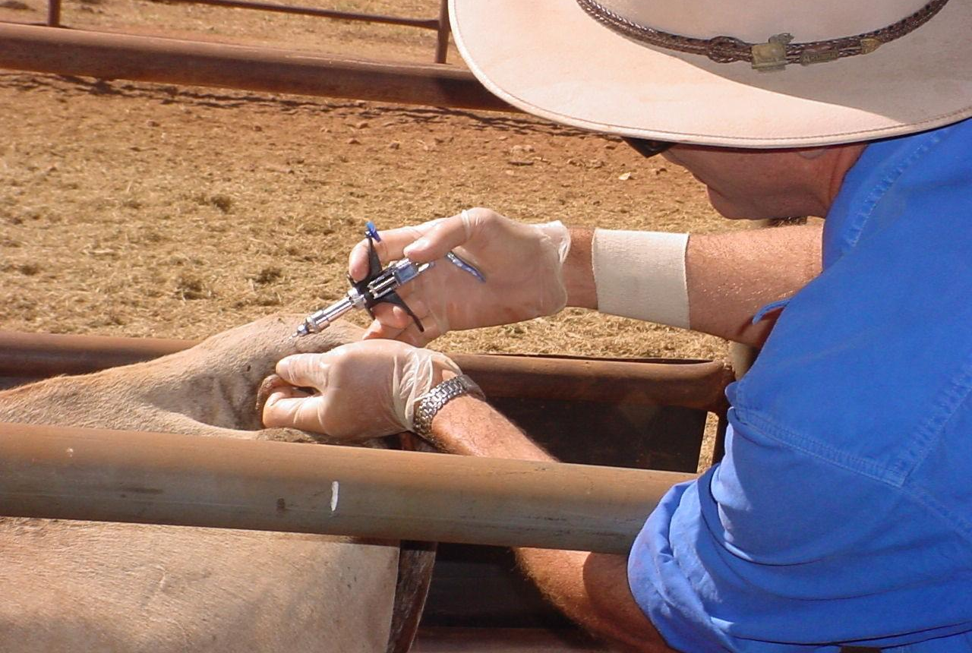
Our view of TB Testing
1. To provide some confidence mob is free
OR
2. To detect infection & depopulate
Not eradication tool by itself
“Only test cattle you think are free”
”Read ‘em hard”
Notes:
So, at this stage it is worth commenting on how we viewed and used TB testing – note that the single caudal fold test was the only one that was practical. This has a sensitivity of at-best 70% - less in cattle that are nutritionally challenged or old.
Essentially, traditional ‘test & slaughter’ does not work under these conditions. We used the test to detect infection and/or indicate lack of infection.
Once infection was found, we depopulated that epidemiological group.

Slide 21
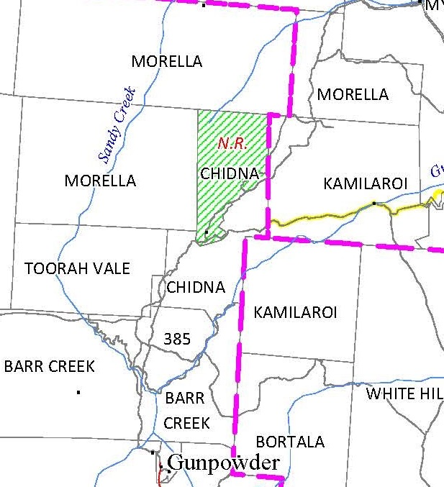
Case Study 2.
27km x 10 km
TB history in neighbours
Very rough country
Never tested
Notes:
At the other end of the spectrum we have this property, which is much smaller, but situated in very rugged country.
While there had been TB present in the vicinity, it had never been detected from here, but also it had never been tested, so this had to be organised.

Slide 22
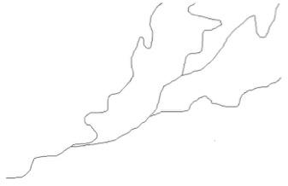
? ?
Notes:
I sat down with the owner and asked him to draw me a ‘mud map’ of his property – a good place to start. He started drawing these squiggly lines, which had me puzzled for a minute.
I then realised that he did not really operate according to property boundaries, but where cattle grazed in gullies (valleys & gorges).
We eventually worked out a testing program in conjunction with the neighbours. Mustering occurred on an area basis, with cattle held & tested, while unmustered cattle were shot.
No TB was found. I provide this example to demonstrate how we needed to adapt to individual circumstances.

Slide 23
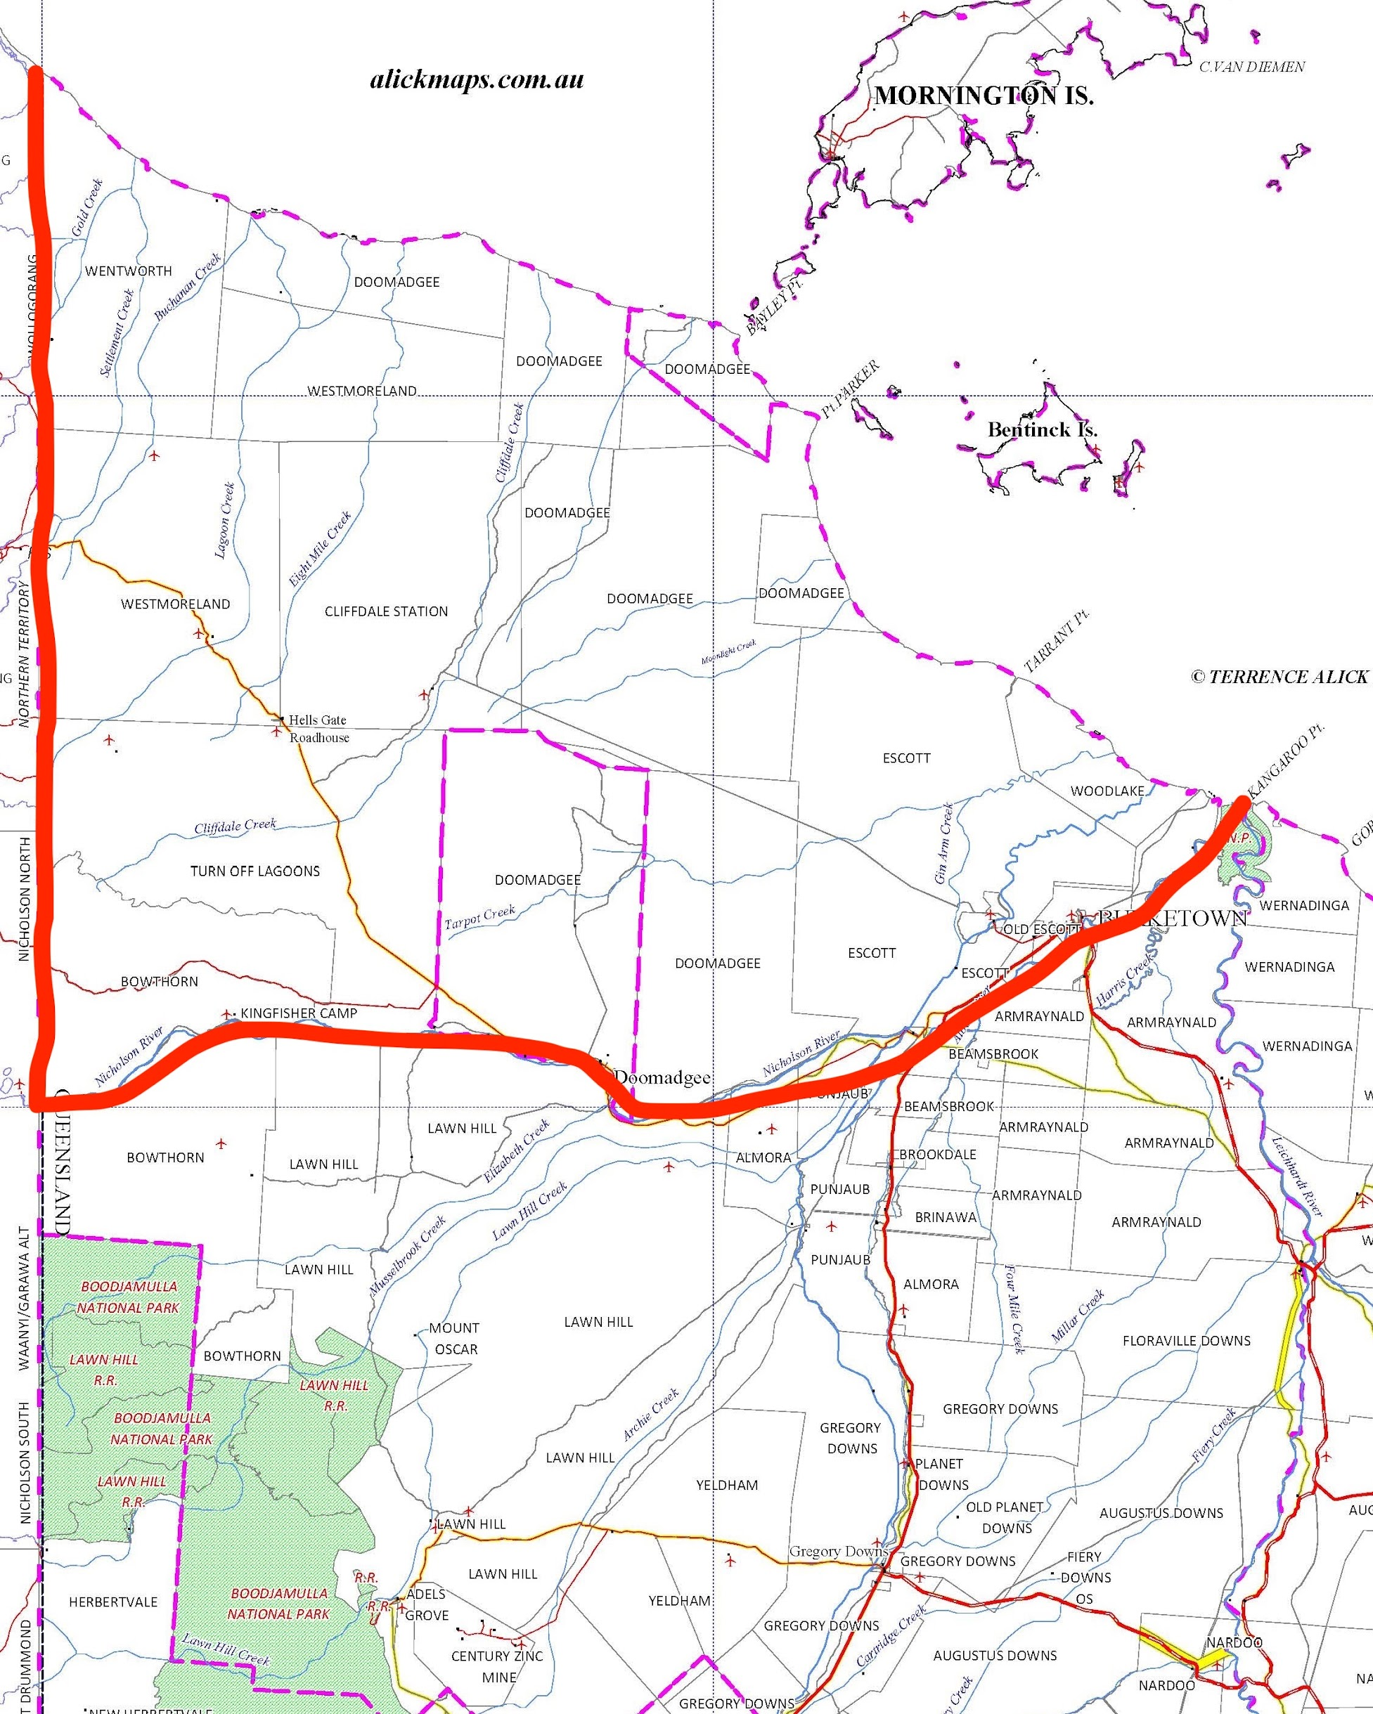
Case Study 3.
10,000 square km
Unfenced
< 1:1000 TB infection rate.
How can we eradicate TB under those conditions?
Notes:
My third case study shows how sometimes we had to take an area approach. The Nicholson area was bounded by the Nicholson river, the Coast and the NT border had 8 main land owners, but virtually no fencing over a total area of 10,000 sq km. It had a low infection rate of less than 1:1000.

Slide 24
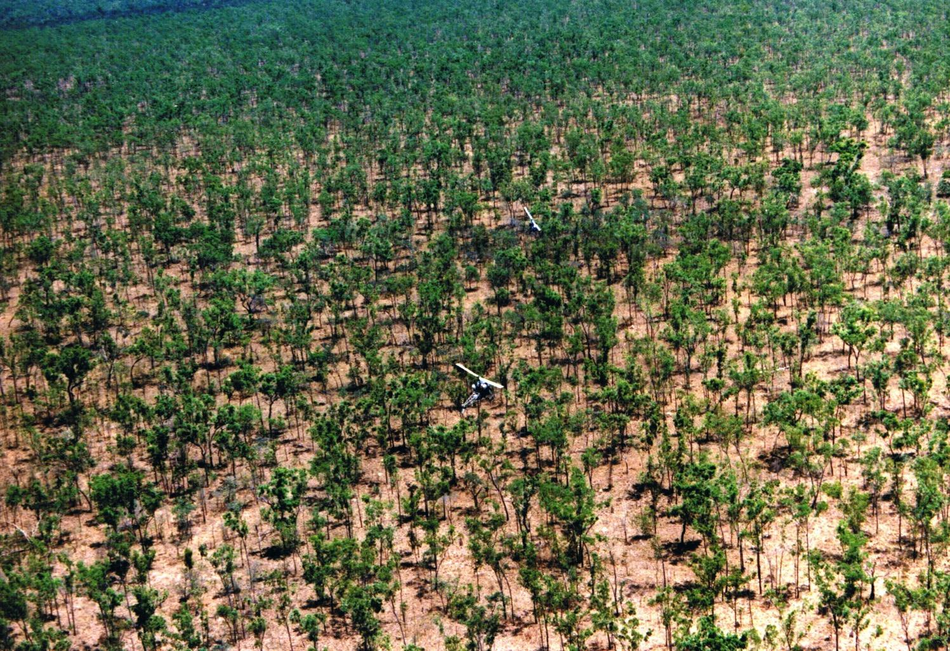
Notes:
The country was flat & fairly featureless.

Slide 25
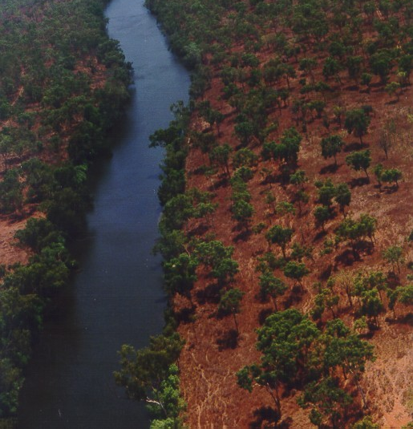
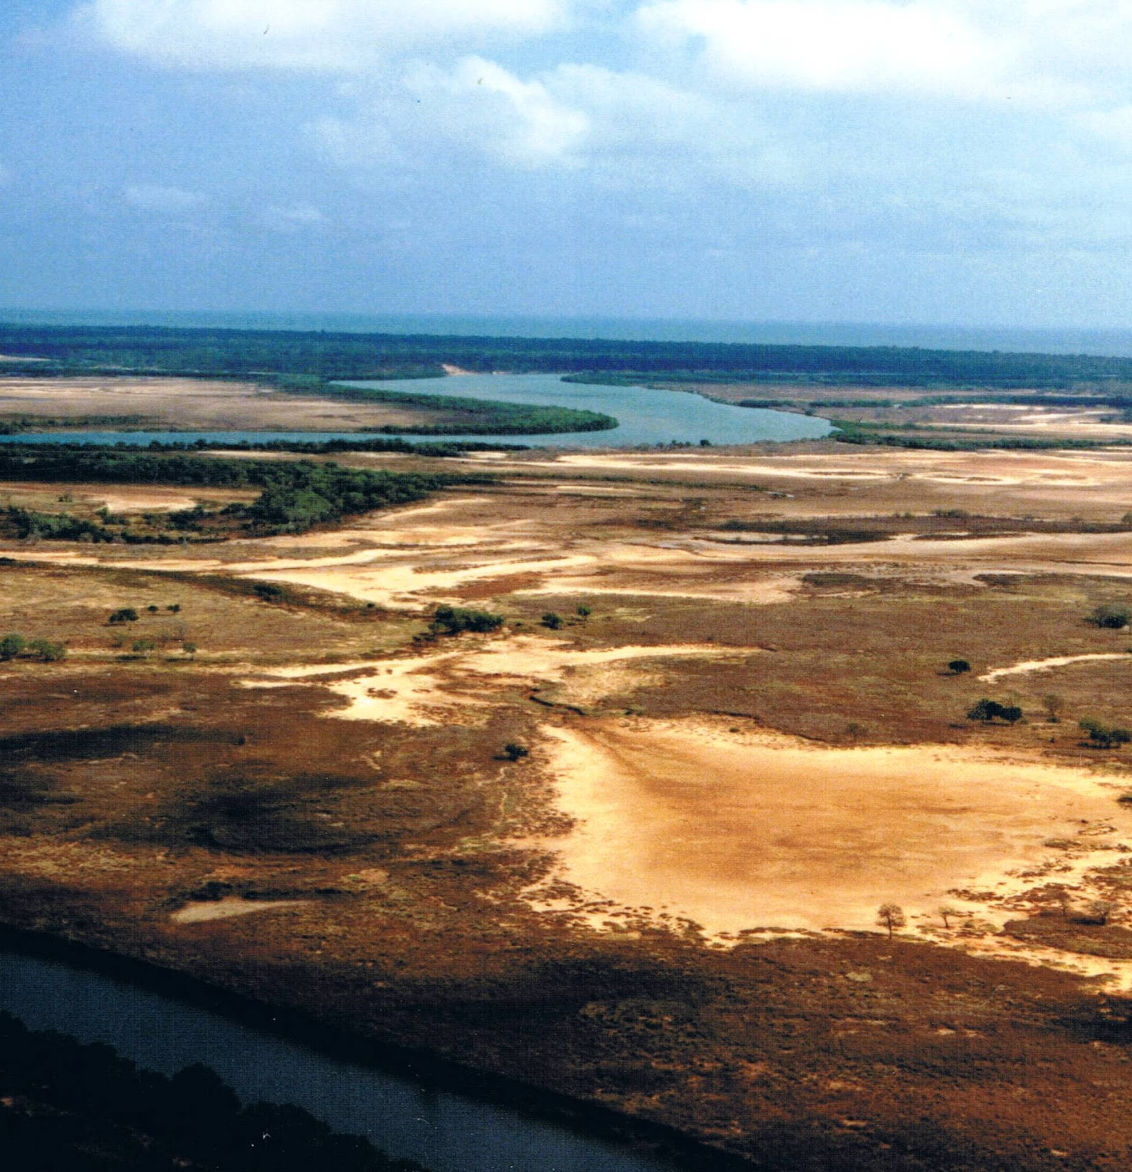
Notes:
With the odd river system and salt flats towards the coast.

Slide 26
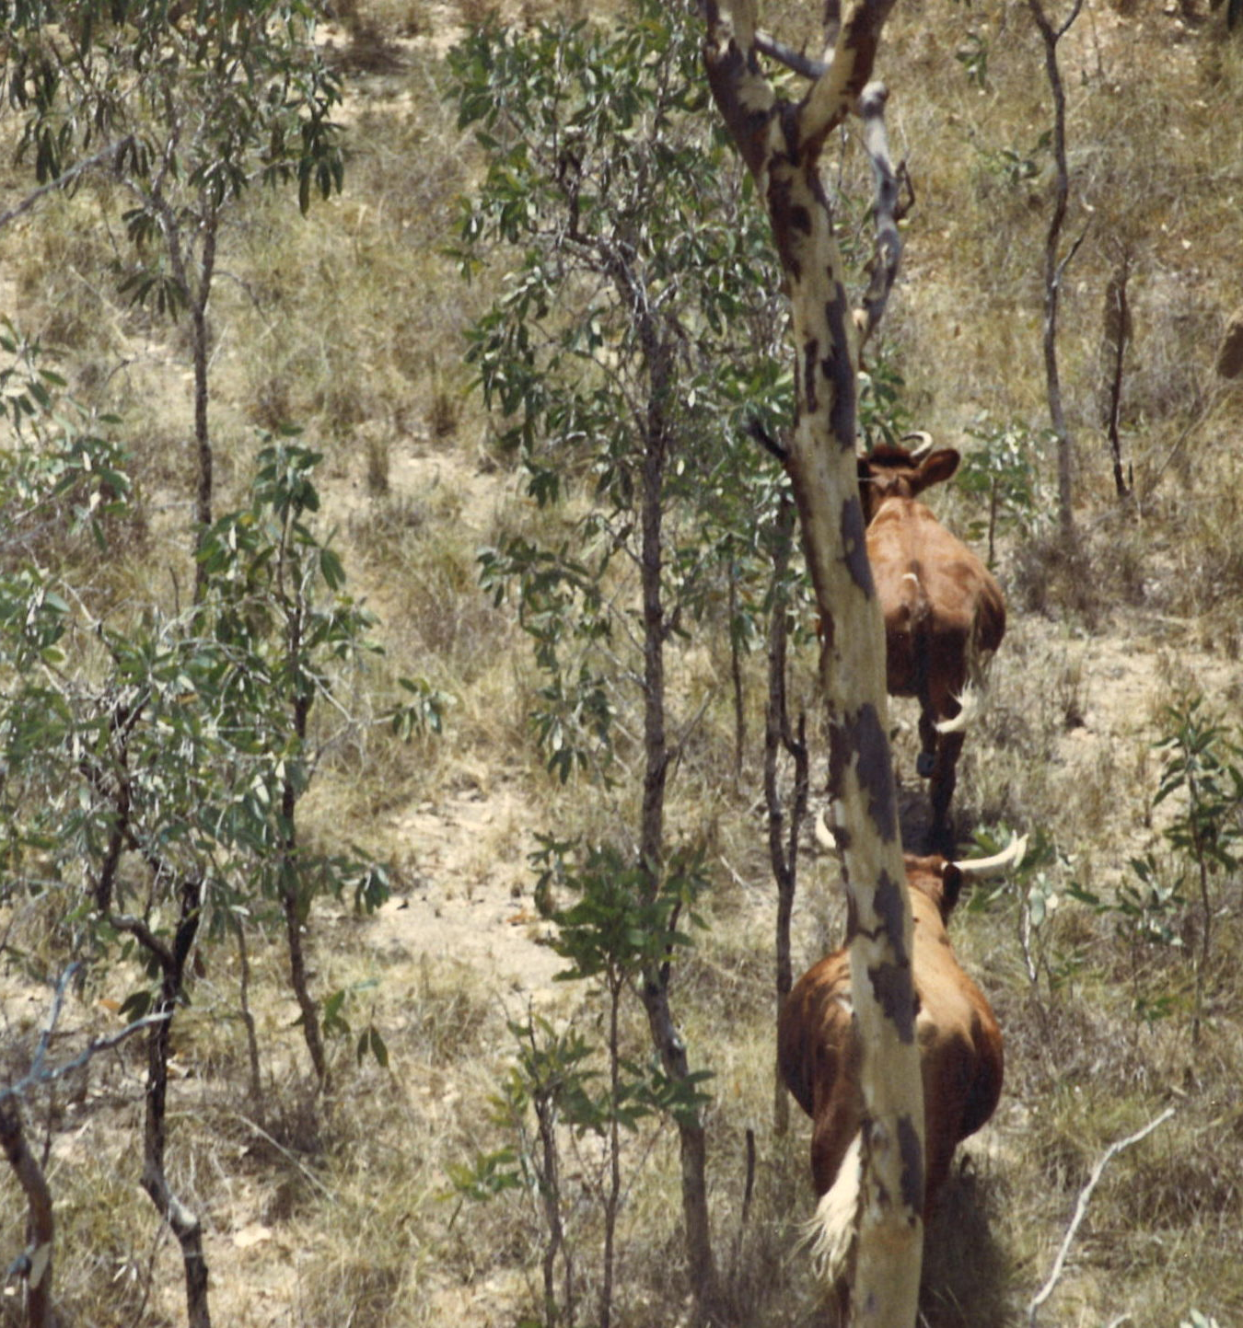
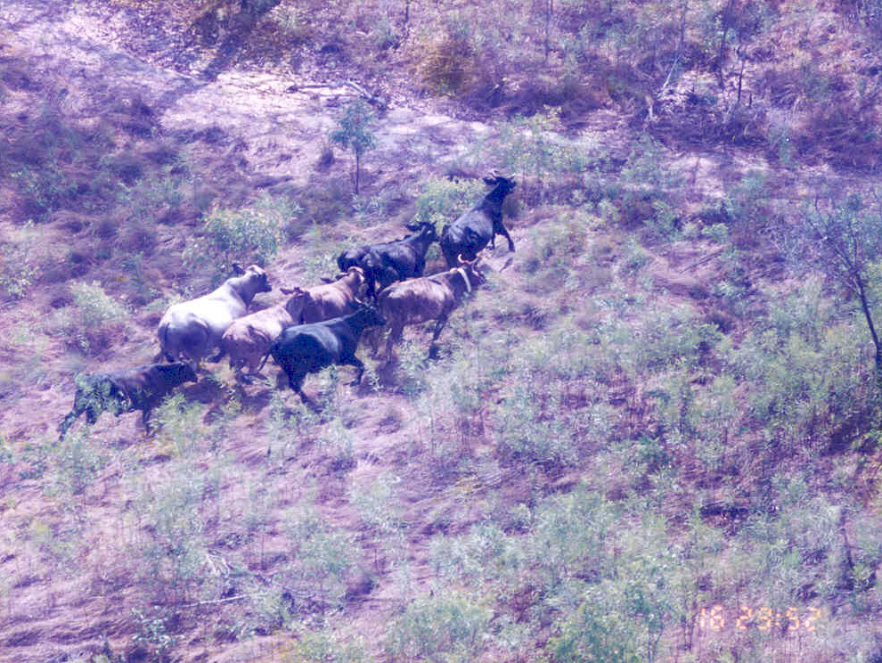
Notes:
The cattle were basically feral.

Slide 27
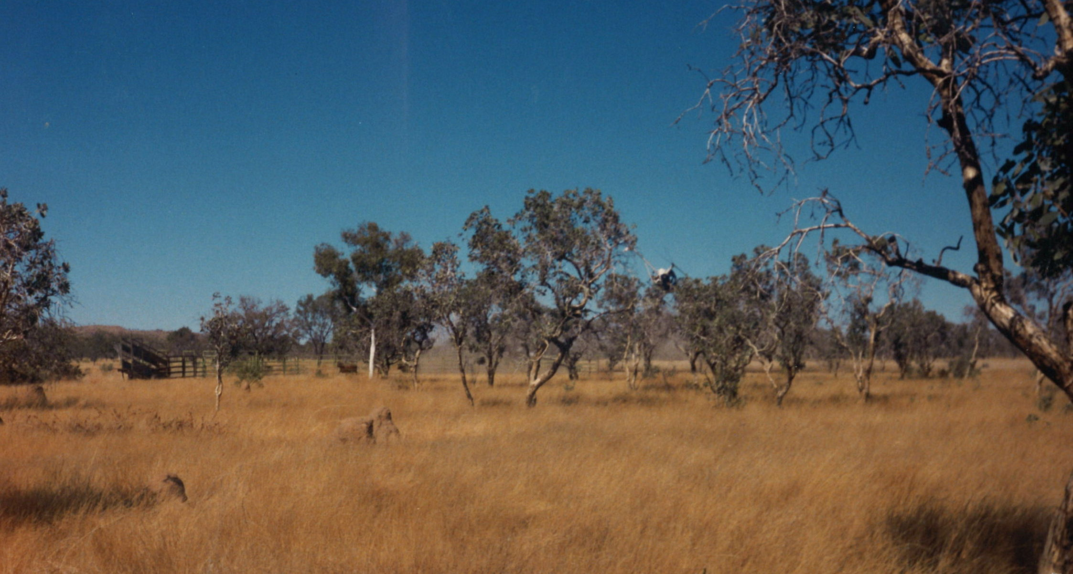
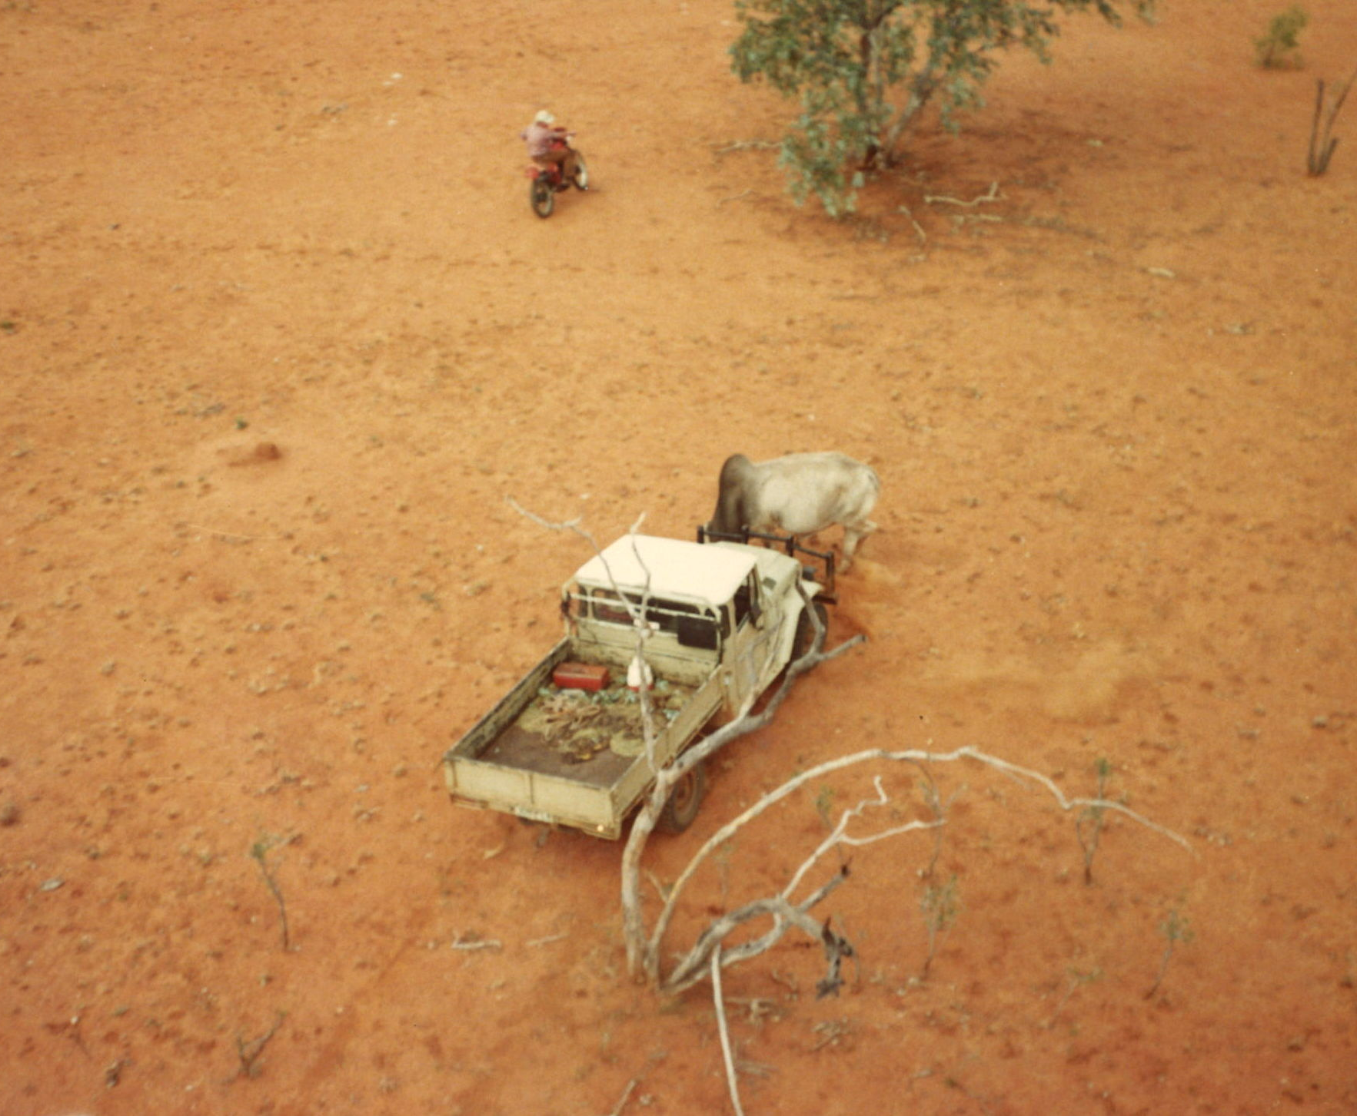
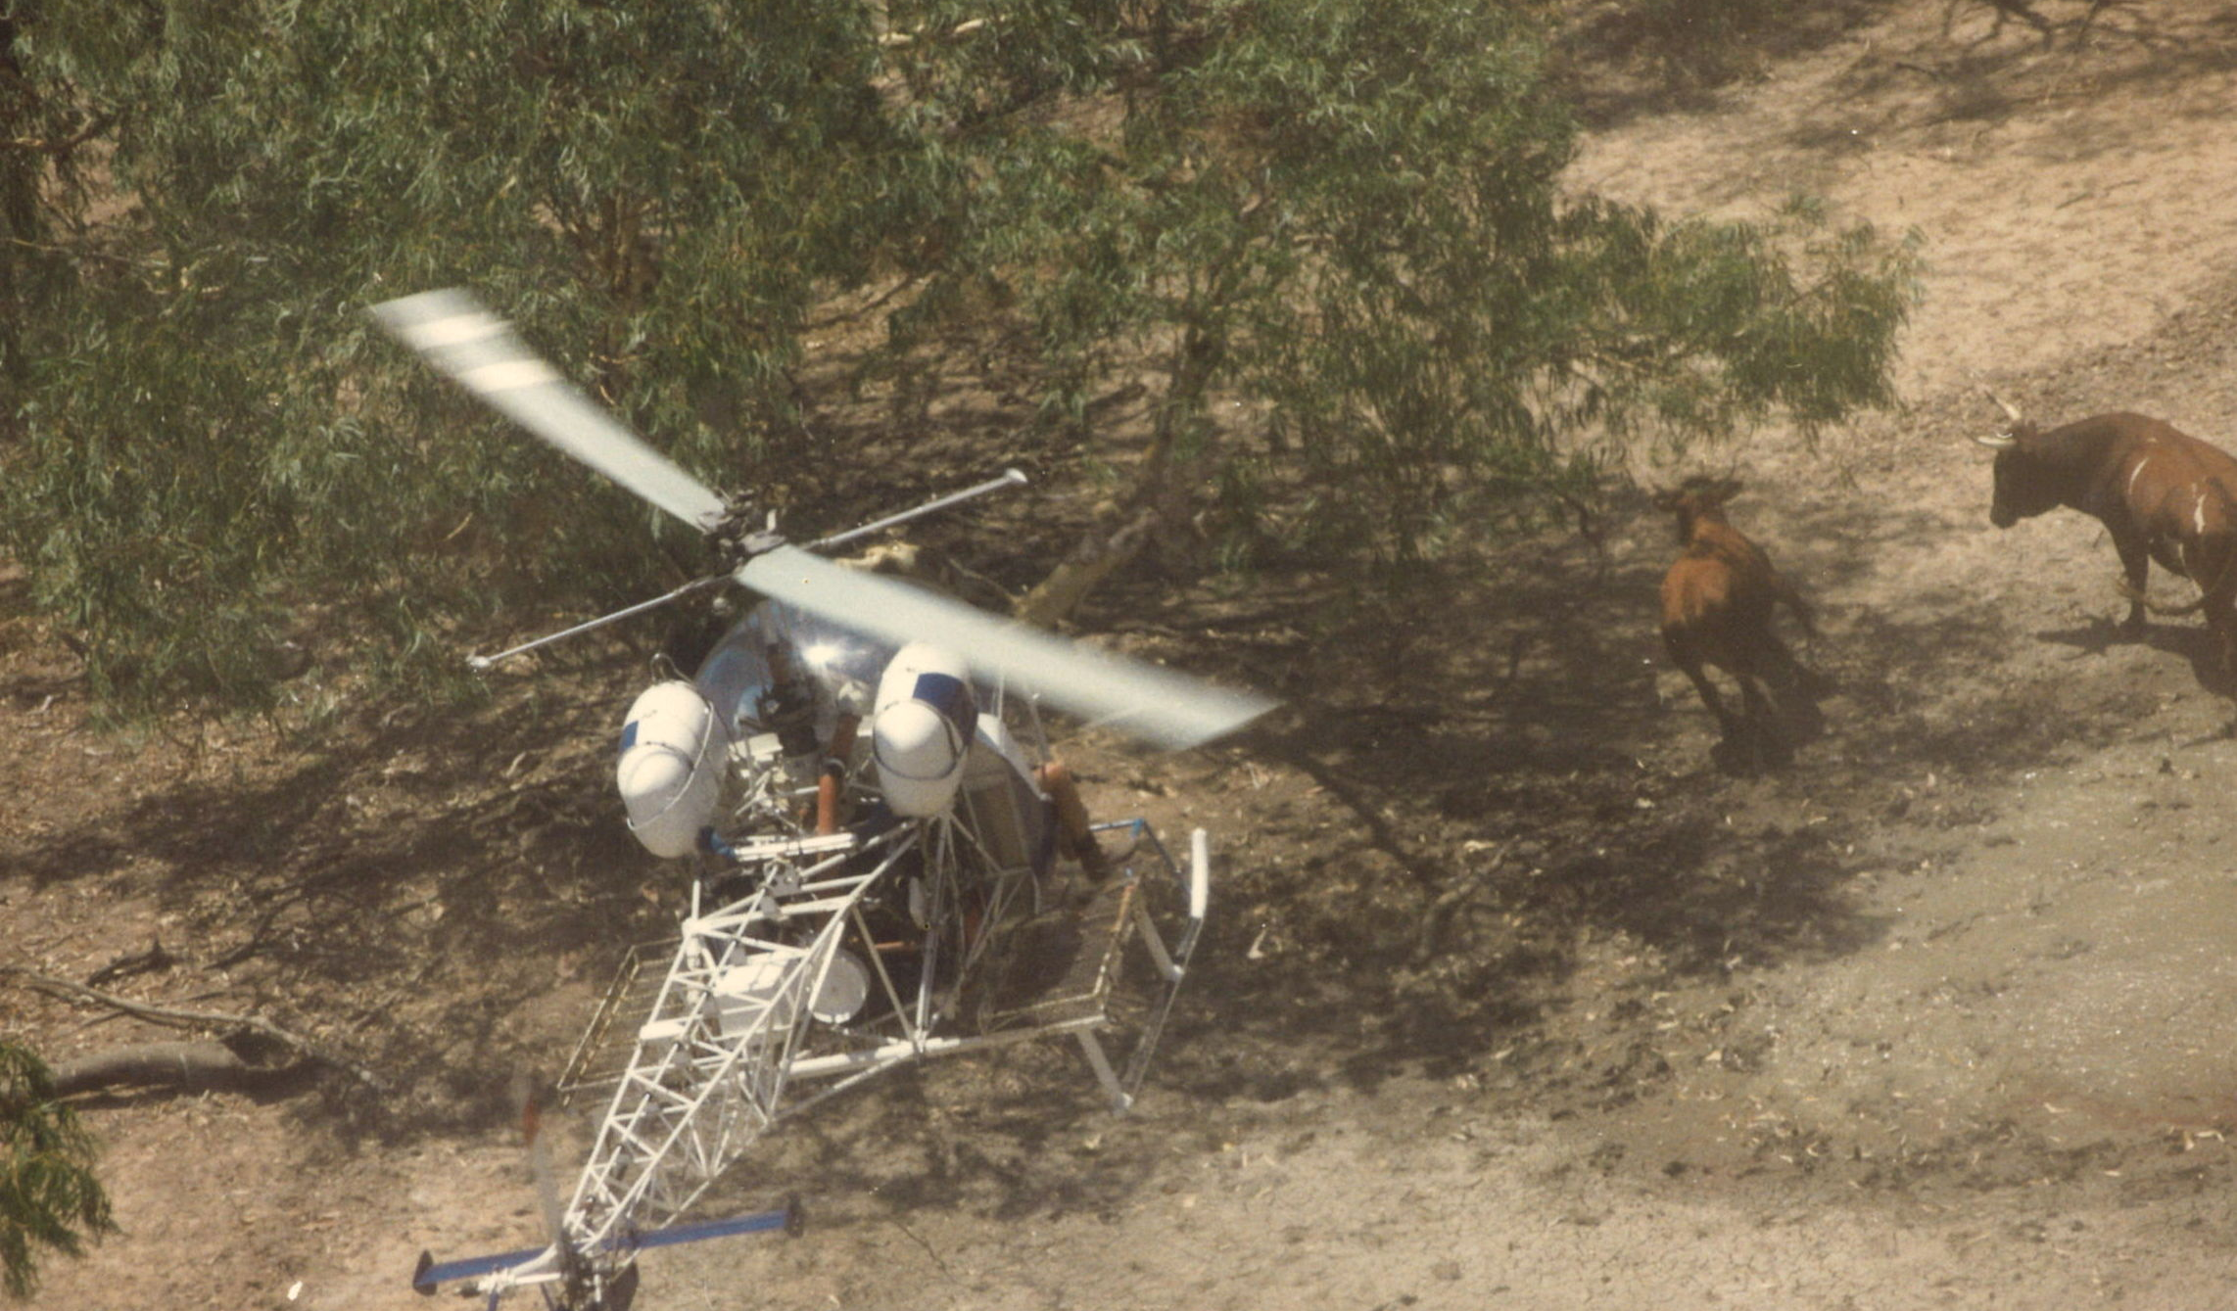
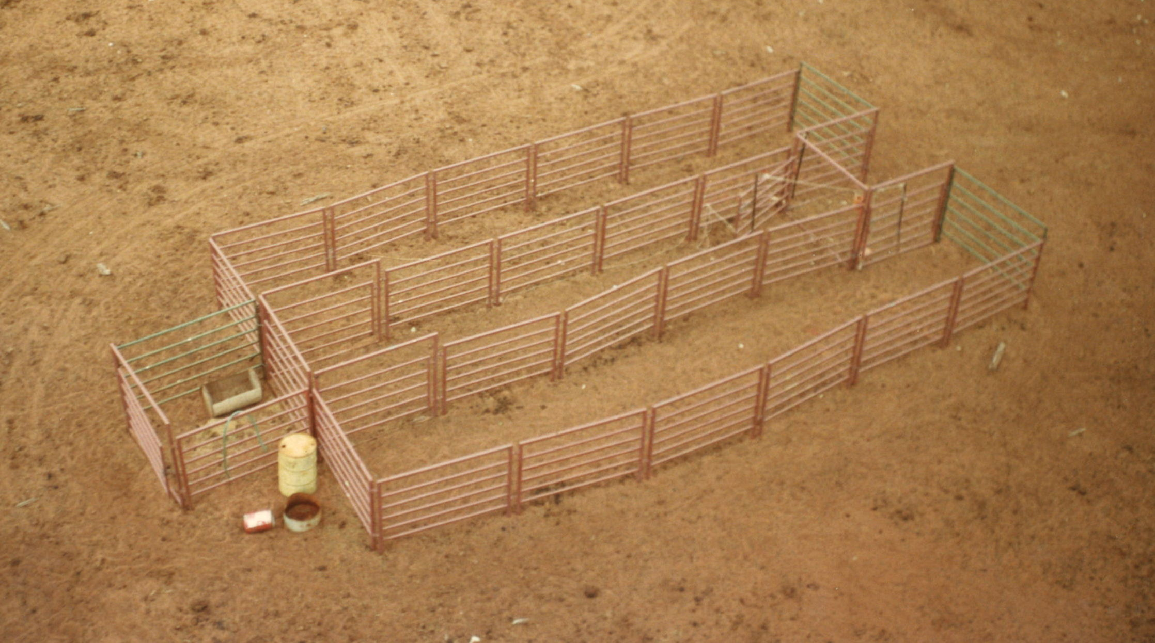
Notes:
So, commercially, it was essentially a harvesting operation.

Slide 28
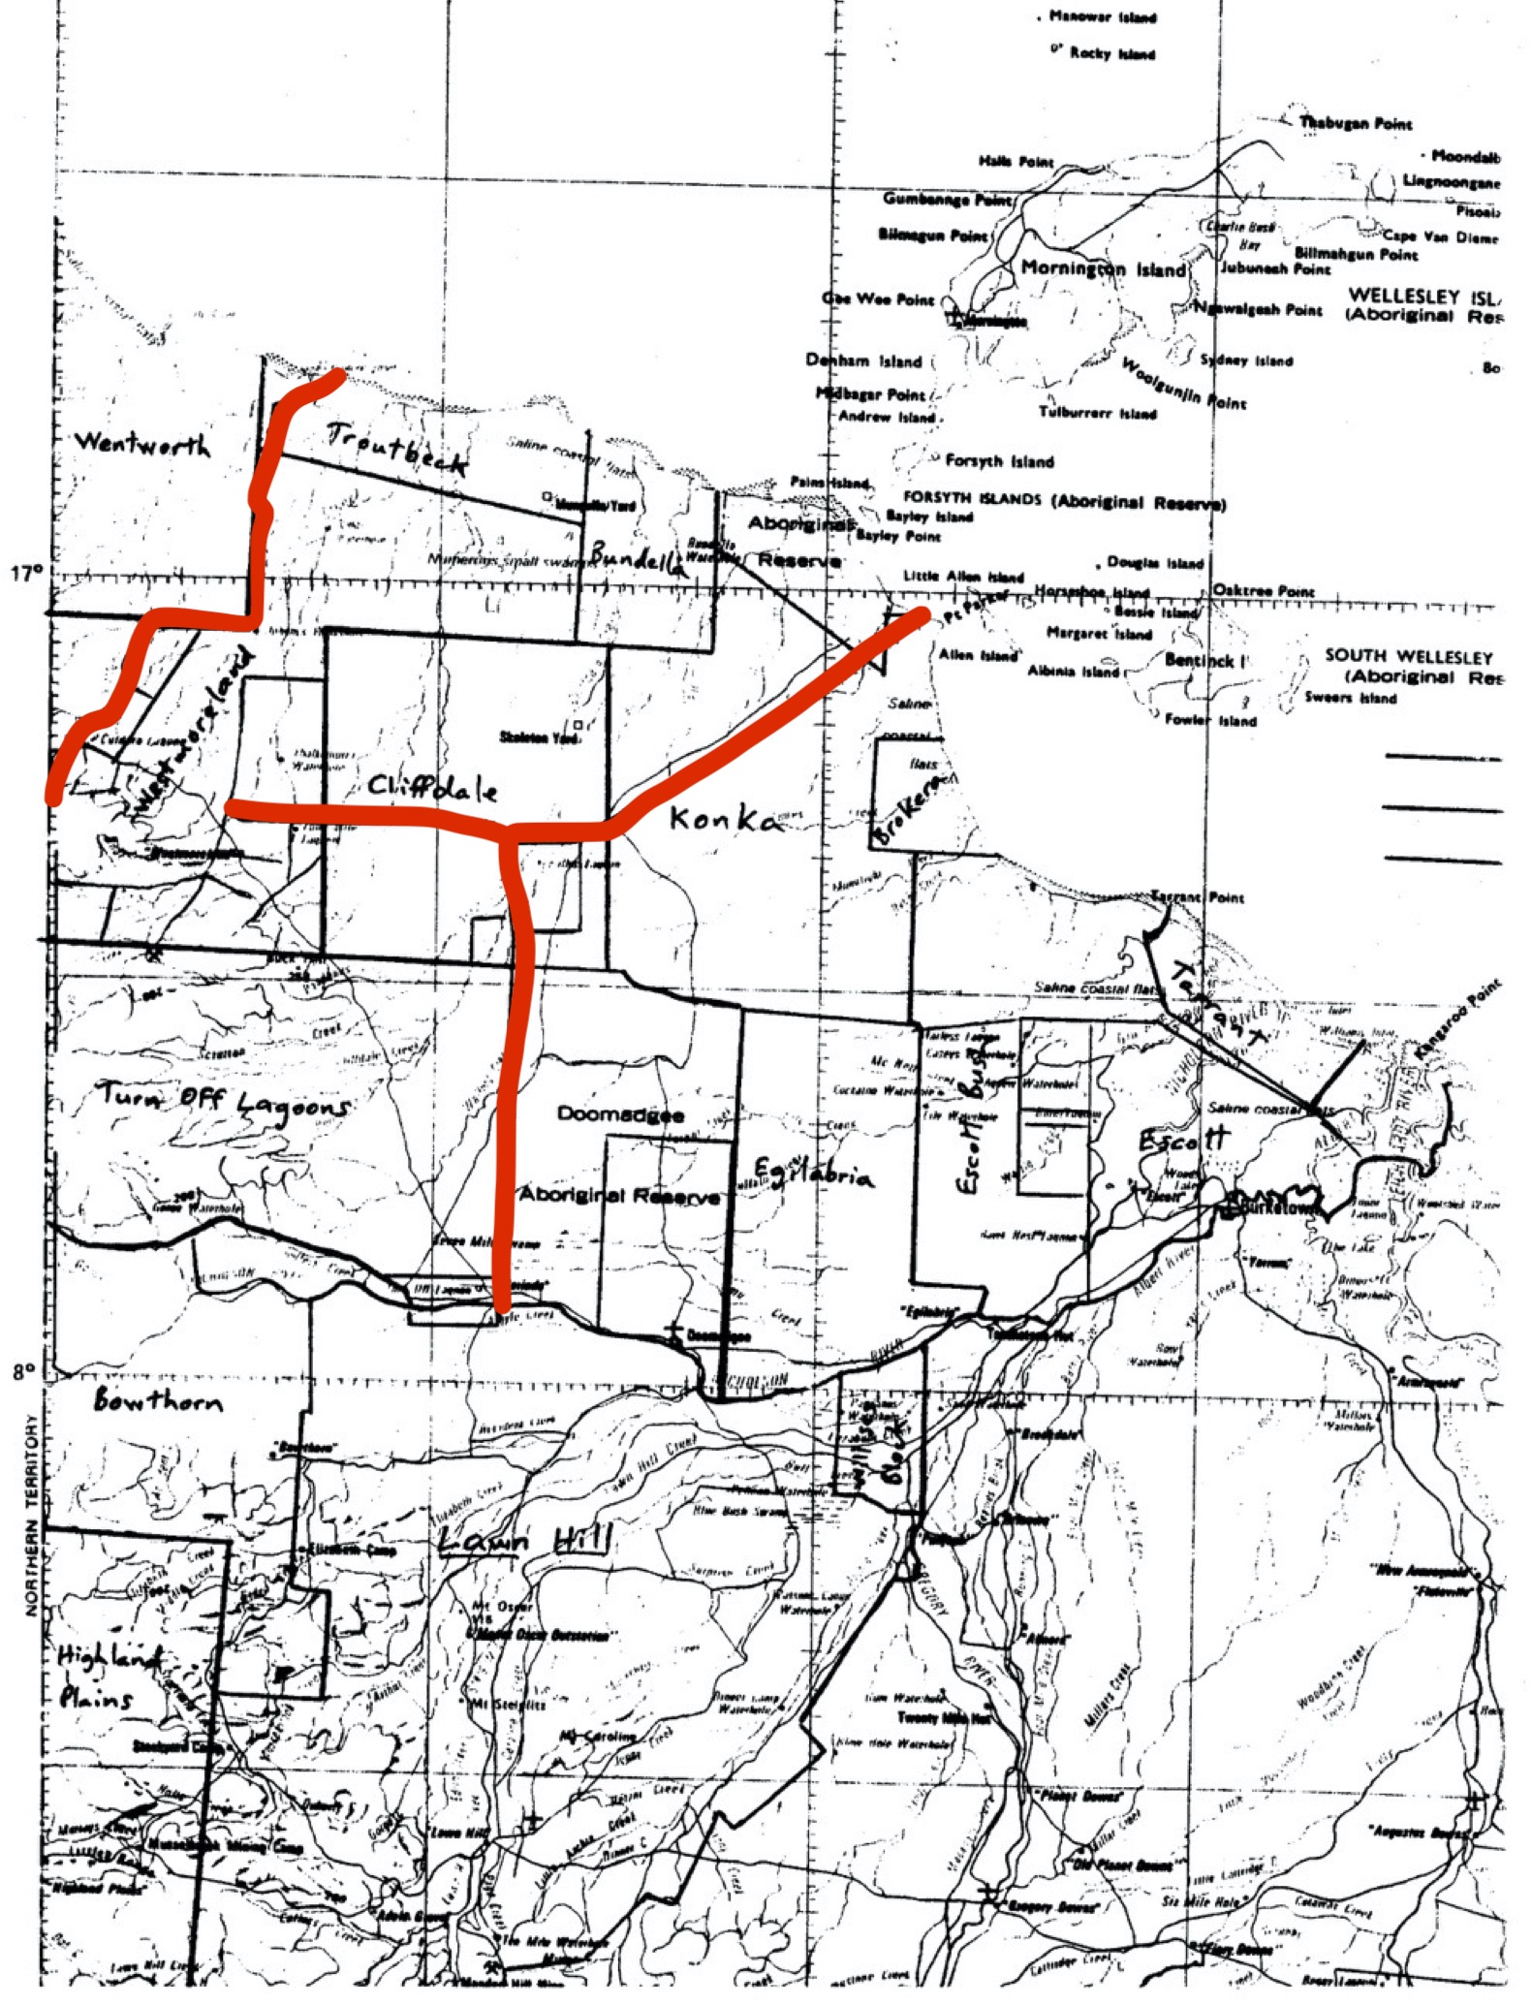
Approach taken
Construct strategic fences & start building paddocks
Muster areas “outside” of paddocks.
Test young cattle into paddocks and send older ones to abattoir
When uneconomic to continue mustering outside areas, destroy remaining cattle by aerial shooting.
Notes:
Explain approach – see dot points. Program paid for strategic fences.

Slide 29
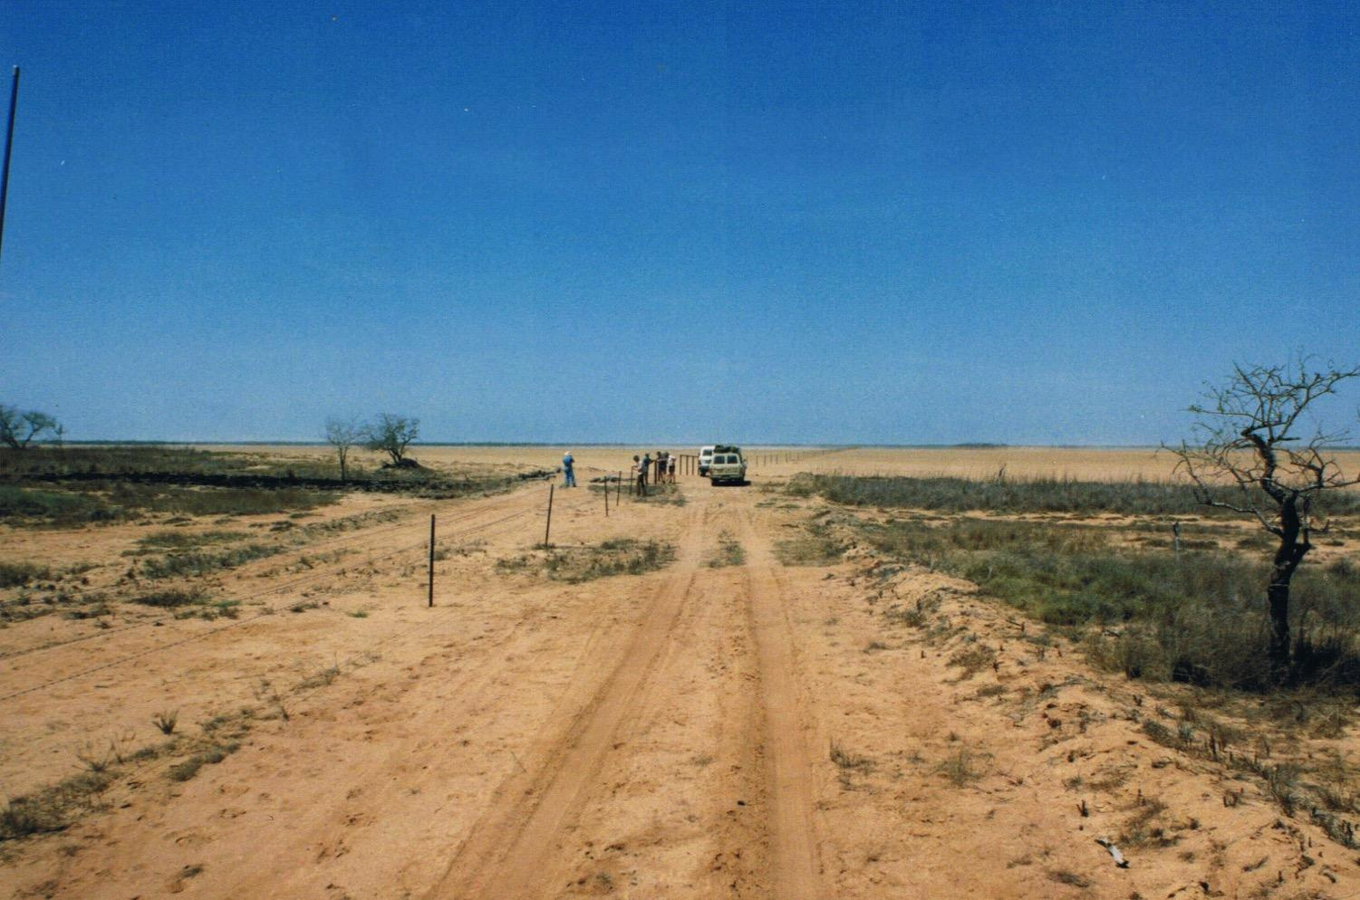
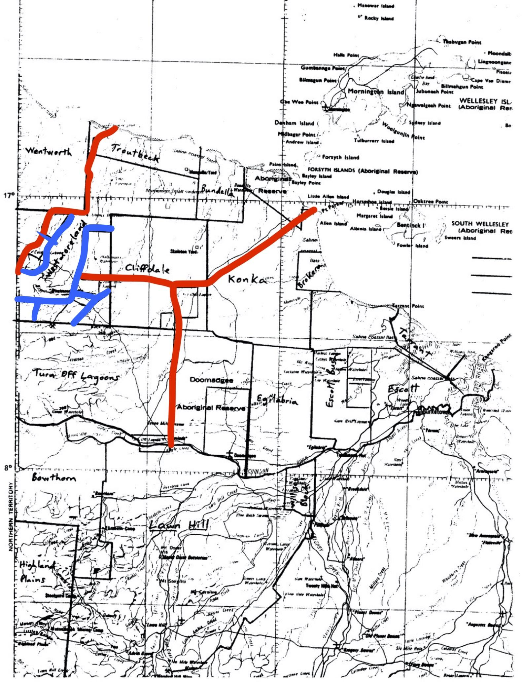
Westmoreland
Notes:
For example, Westmoreland built the ‘blue fences’ using strategic fences and gradually built up a tested herd that could then be properly managed.

Slide 30
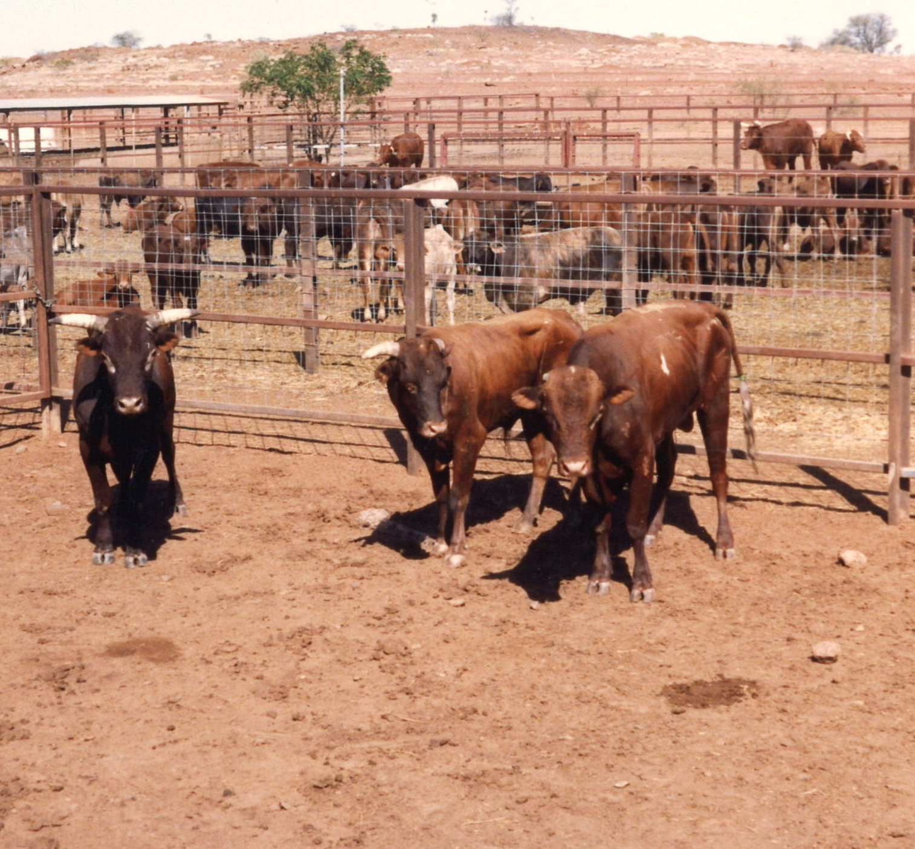
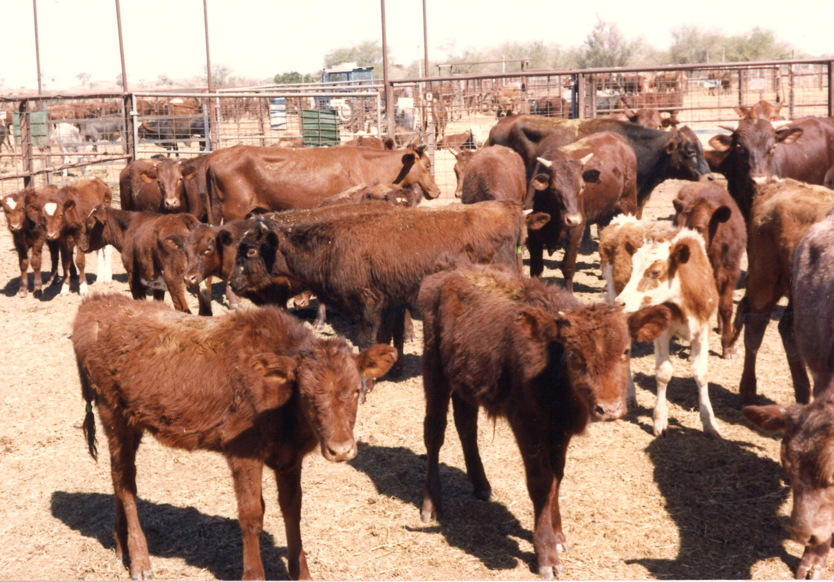
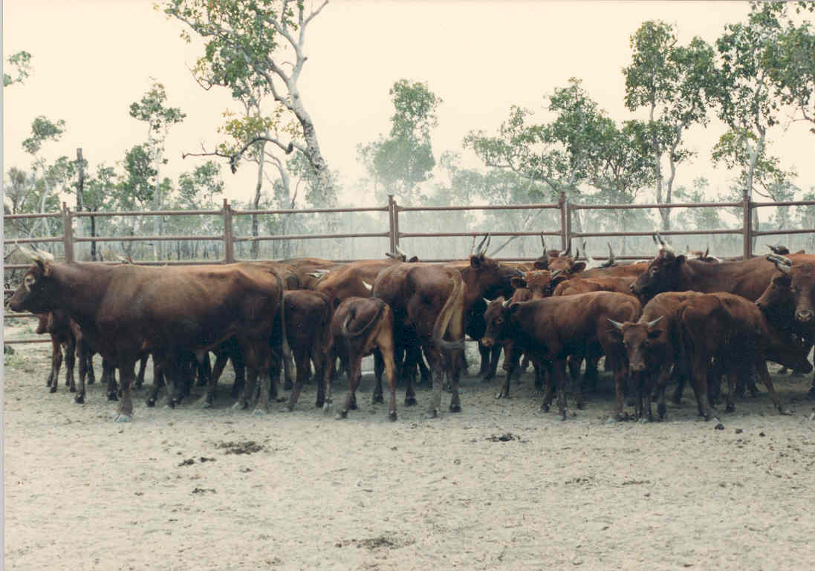
Destock Cattle
Notes:
Example of some of the poor quality feral cattle destocked.

Slide 31
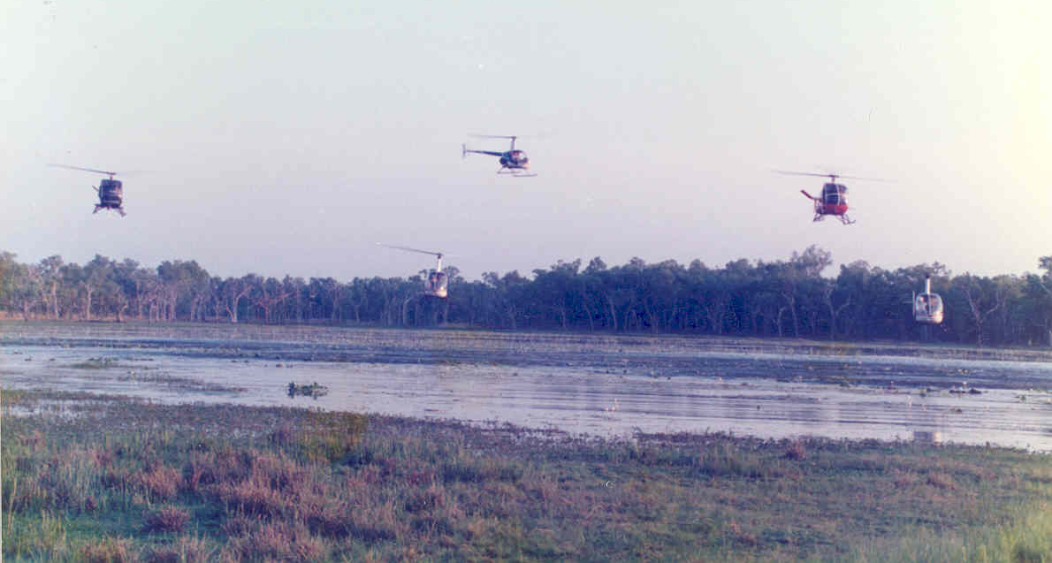
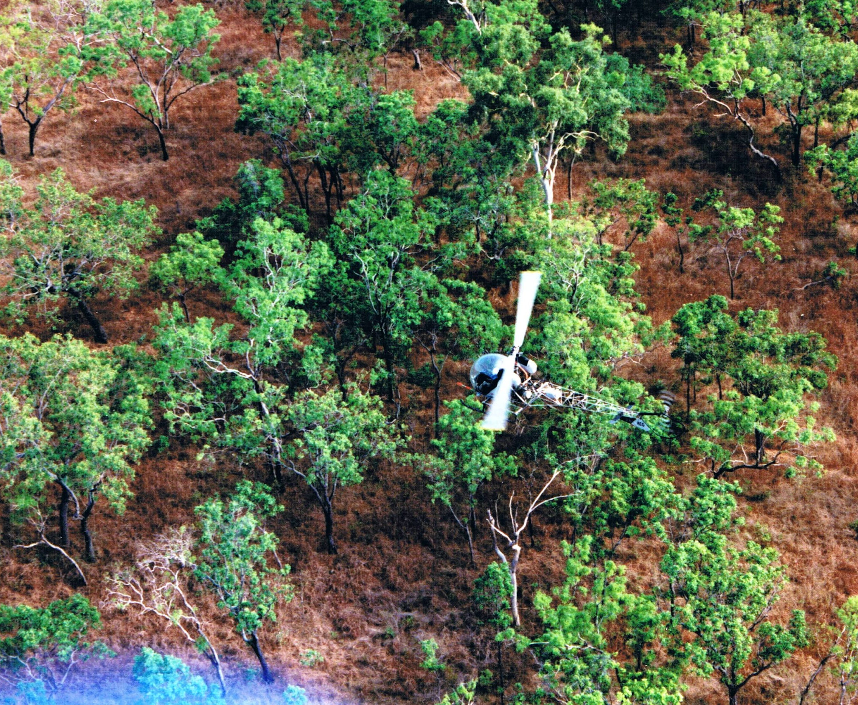
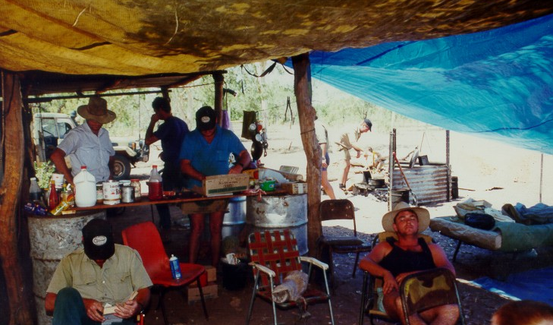
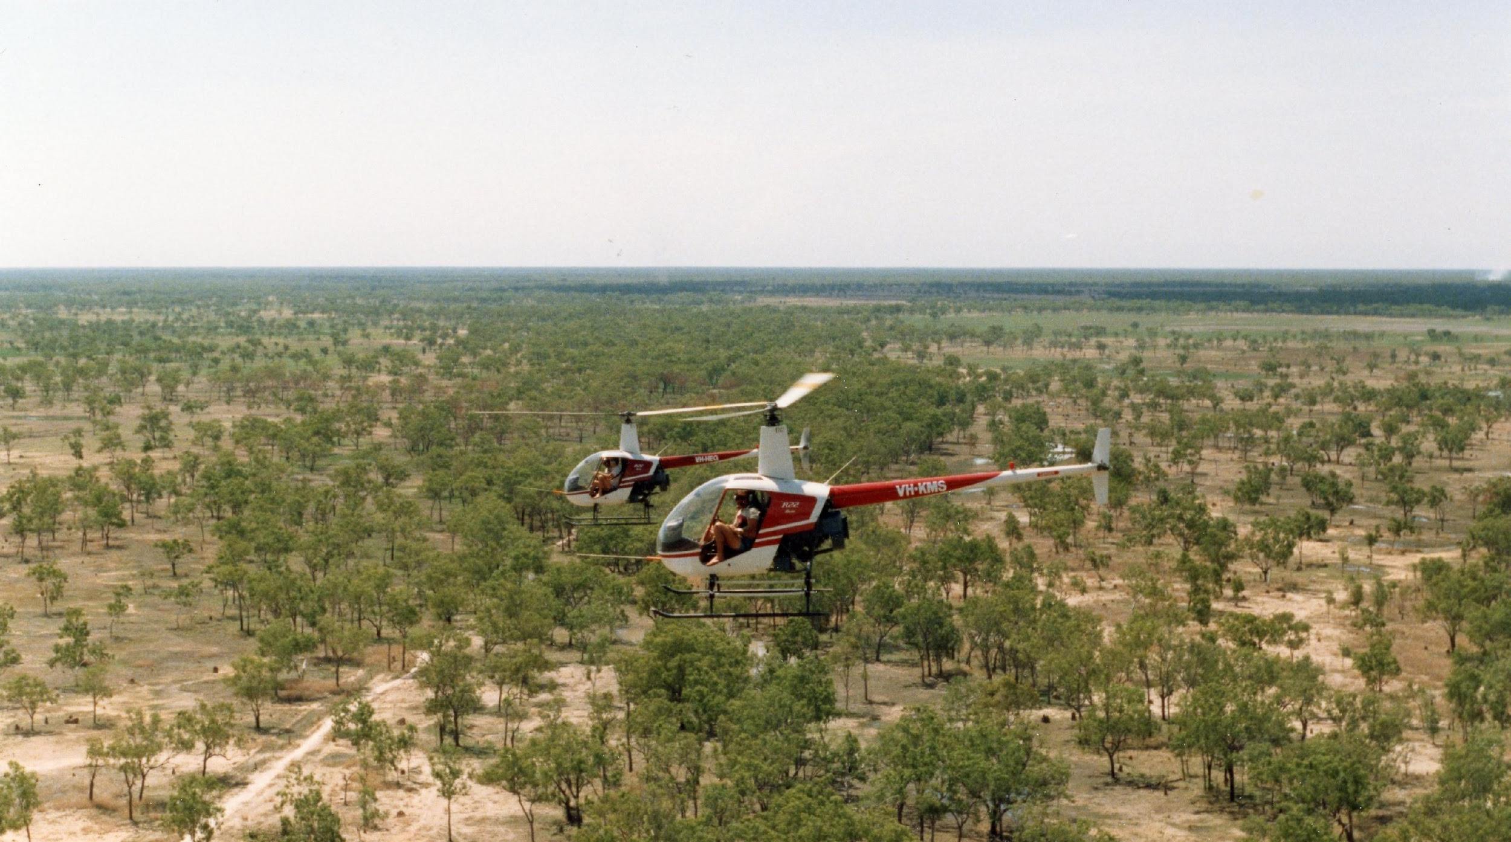
Notes:
When it became uneconomic to continue mustering the unfenced areas, the land was handed over to the department and we carried out a series of depopulation exercises by shooting the remaining cattle from helicopters - a large logistical exercise.

Slide 32
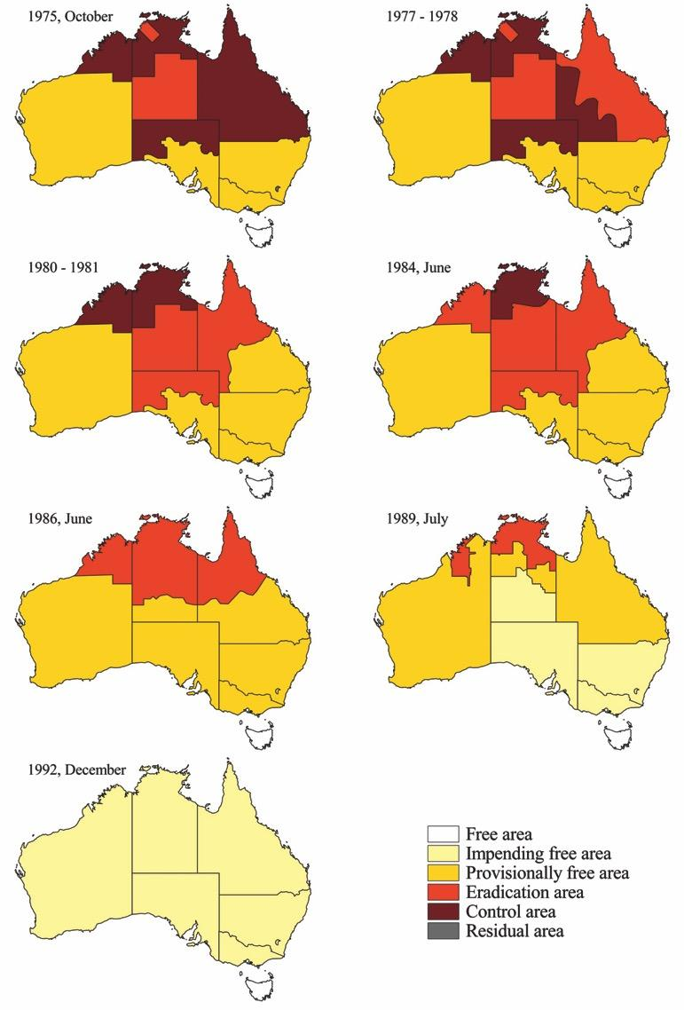
BTEC:
The National Context
Notes:
So, how does this on the ground activity relate to the national agenda?
I mentioned earlier the date to reach impending freedom in the north. This was just one of a series of progressive area status changes that drove progress, essentially from the south to the north.

Slide 33
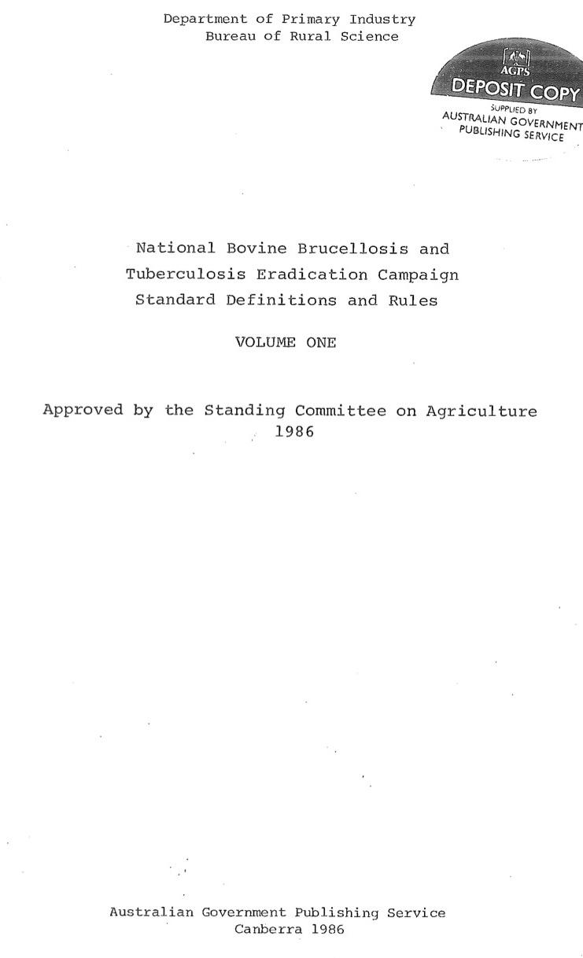
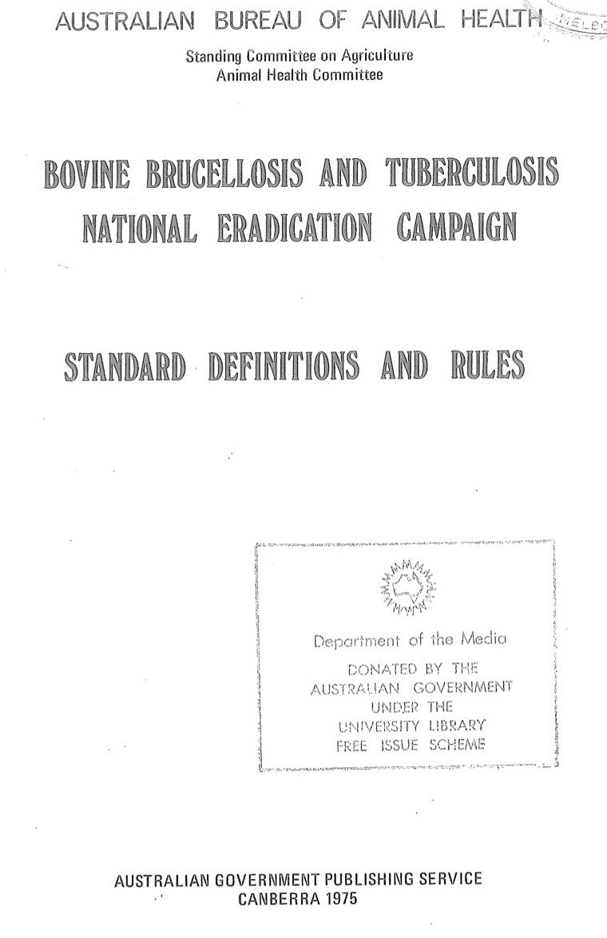
Notes:
I also mentioned earlier the SDRs and there were a number of revisions of these over the years.
It’s important to realise that the Australian States are a bit like 7 separate countries, so these were important for consistency.

Slide 34
Notes:
The SDRs covered a range of issues, including herd and area statuses, testing requirements, animal identification, abattoir monitoring etc.
Again, I won’t go into this in detail, but see me after if you need to see more.

Slide 35
Controlling Movements
Notes:
A key driver for action by cattle owners was controlling movements.
This very old analysis shows the relationships between cattle stations and the movement of animals from breeding properties in the north for fattening in the south. This was a major cause of TB spread & persistence.

Slide 36
Notes:
So the SDRs specified what movements were allowed, determined by herd and area status. These were made progressively tougher as the program progressed.
It stopped the spread of disease and provided a huge incentive for producers to eradicate.

Slide 37
BTEC – Industry Partnership
Notes:
Another very important element was the government – industry partnership. At the start, the program was largely government driven but in the early 80’s the industry wasn’t happy and demanded a greater say in what happened. This led to formation of state and national BTEC committees to set overall policy and direction….., as well as these gents – Ministerial BTEC advisors. These were industry nominated people and they played a very valuable role in helping resolve on-the-ground issues on problem properties. I found that industry was often tougher on their members than govt staff.

Slide 38
“He/SHE Who Pays, Has a Say”
Funding
50% Industry through levies
20% Commonwealth Government
30% State Governments
National and State BTEC Committees
Notes:
So, what we ended up with was a funding formula where industry paid for half of the program and had a strong say in strategic decision making.

Slide 39
Assistance Measures
Compensation for animals destroyed or depopulated
Mustering subsidies
Freight subsidies
Low interest loans
Taxation concessions
Advisory services
Notes:
One of the changes to the program influenced by industry was a greater suite of assistance measures to reduce the financial impact on affected producers.
Particularly mustering, freight subsidies, low interest loans etc.

Slide 40
Sometimes we just had to get tough.
Notes:
Despite the carrots and sticks that we used to encourage people to participate, there was still the occasional hold-out.
In this case, we took this grazier to Court and received a ruling that enabled the Department to complete the required eradication activity.

Slide 41
Notes:
Towards the end of the program we also had to implement some innovative methods to overcome particular problems.
I don’t have time here to talk about TB in water buffalo. The Judas cow technique was developed to deal with areas of very dense vegetation where it was difficult to find cattle.
Here, a cow is caught with a tranquilizer dart and a radio collar installed.
If asked, can talk about water buffalo - targeted depopulation of infected populations based on surveying. ~350,000 at start; ~ 50,000 at the end.

Slide 42
The Judas Cow
Tracking Judas Cows.
Cattle are social animals - find her, then shoot companions.
Then repeat the process.
Notes:
Periodically she is tracked and her companions shot.

Slide 43
BTEC Legacies
Notes:
BTEC has had a number of ongoing legacies in Australia. In fact, BTEC underpinned our animal health system for many years.

Slide 44
Notes:
I mentioned the cartoon series, Bluey at the start. This is BTEC legend, Stock Inspector, Bob Brumm. He was a Vietnam veteran and developed our shooting from helicopters training course. This was vital for staff safety, as well as animal welfare reasons. Unfortunately, we still lost one stock inspector, John Fry in a helicopter crash.

Slide 45
Notes:
Bob was best mates with another stock inspector, John Kelly

Slide 46
Notes:
John had a very faithful dog called Bandit who can be seen here sharing a swag with his owner. Incidentally, this is how we generally slept when out in the bush.

Slide 47
Notes:
Bob Brumm also had a son, Joe who grew up to be an animator and the the creator of Bluey.

Slide 48
Notes:
..and the name of the father dog in Bluey is?……Bandit.

Slide 49
Modernised industry from this…..
Notes:
A lasting on-the-ground legacy is that BTEC was the catalyst for many in the industry to modernise. So we went from this:

Slide 50
To this.
Notes:
To this…through improvements to cattle control, breeding etc.

Slide 51
Partnership Approach – Shared Responsibility
Notes:
The partnership approach has persisted and is now an imbedded philosophy within our biosecurity system.

Slide 52
Notes:
For example, it is embodied in Animal Health Australia, which is a formal industry – government partnership that coordinates a lot of national animal health programs.

Slide 53
EADRA
Notes:
Our national emergency animal disease response agreement was built on the BTEC experience and again, is a formal government-industry partnership.
I would add that bovine TB is now listed as an Exotic disease under EADRA.

Slide 54
Livestock Identification
Notes:
Our property registration system and tail tag tracing system was developed for BTEC
and has now been extended to electronic identification and animal tracking.

Slide 55
National Livestock Identification System Tracing
Notes:
So, we can now achieve almost real-time animal tracing.

Slide 56
Notes:
Following BTEC we established the Tuberculosis Freedom Assurance Program and a granuloma submission program, with a major focus on enhancing detection at abattoirs to pick up any residual infection.

Slide 57
Breakdowns Post Impending Freedom
Notes:
After we reached impending freedom status we recognised that we would continue to detect some cases. However, these were mostly single, lesioned animals with no others found following investigation.

Slide 58
Last Known Primary Case
579,000 ha (5,856 km²)
14 main paddocks
Brahman cross herd of up to 40,000 head.
Long TB history
>20% in bulls at slaughter 1970s
Control and eradication commenced 1972. Mix of testing and destocking.
Last recorded TB case 1991. Confirmed free status by 2000.
Notes:
However, we still had to treat these cases seriously. This was our last primary case of bovine TB.
Summarise history above.

Slide 59
Year 2000 Breakdown
August and October 2000 – 2 infected cows found at slaughter (7-8 year old).
Compulsory destocking of River and Western paddocks undertaken in 2001.
No TB lesions found in over 8,000 animals.
Notes:
Summarise above

Slide 60
2002
all remaining cattle over 5 years destocked, with remainder tested.
9,533 destroyed or destocked.
33,169 tested. All reactors destroyed & no TB detected.
All unmustered cattle shot and post mortemed where possible.
Repeated 2003/4… and 2006
Notes:
Summarise above

Slide 61
TB Eradication Success Factors
Industry & Government
Commitment
Funding &
Cost Sharing
Program
Management
Agreed Technical
Standards
Legal Backing
Abattoir
Surveillance
Tracing
Strict Controls
Testing
Movement controls based on status
Targeted depopulation (residual infection)
Compensation and subsidies for affected farmers
Notes:
So, thank you for listening. To summarise the key BTEC success factors - see above

Slide 62
Challenges
Industry & Government
Commitment
Persistence &
Be Prepared to be Tough
Funding &
Cost Sharing
Program
Management
Agreed Technical
Standards
Legal Backing
Abattoir
Surveillance
Tracing
Strict Controls
Testing
Movement controls based on status
Targeted depopulation (residual infection)
Compensation and subsidies for farmers affects
Notes:
…and I guess we were somewhat lucky that we didn’t have wildlife reservoirs, apart from feral buffalo.

Slide 63
TB Eradication Success factors – Intangibles.
Notes:
I’m sure that there were also some intangible factors, for example this recent study showed that despite Australian’s larrikin image, we are essentially a compliant culture.

Slide 64
The Last Day
Notes:
So I’ll finish with a few photos of the last day of testing on the last TB infected property.
…and the last cow who wouldn’t go up the race, so was read where she was in the back yard.

Slide 65
Notes:
I would like to acknowledge the many thousands of people, both from government, industry and the veterinary profession who contributed to our success.
I’d also like to thank my former staff who contributed many of the photos I’ve used today.

Slide 66
THANK YOU

